Slide 1
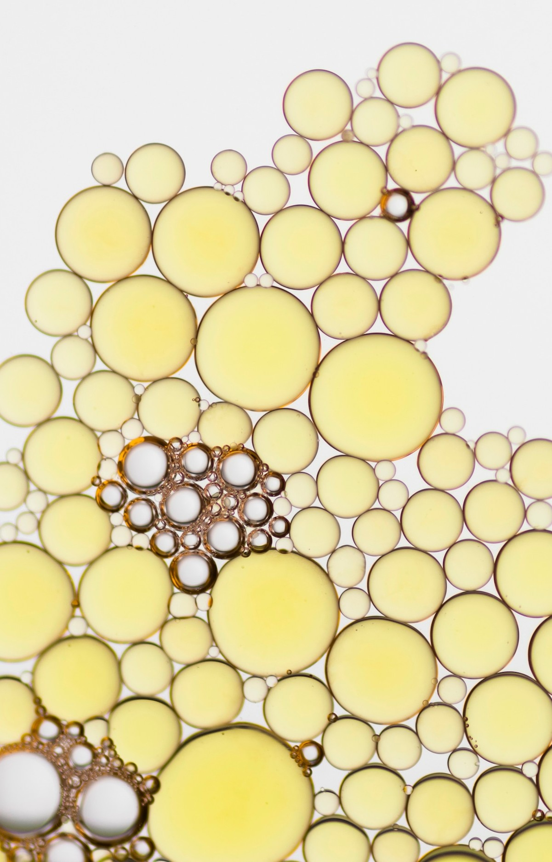
Cell: The Fundamental Unit of Life

Slide 2
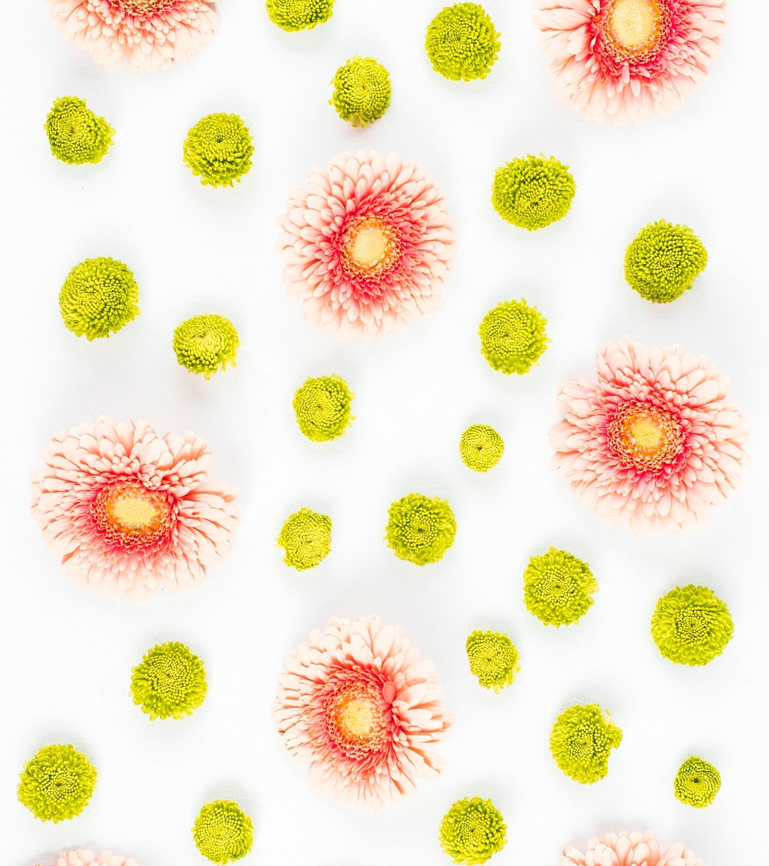
Introduction to Cells
The cell is often referred to as the "unit of life" because it is the smallest structural and functional unit of an organism. Cells are the building blocks of all living things, from the simplest bacteria to complex plants and animals. Cells are the basic building blocks of all living organisms.
Organism can be of two type:
Unicellular – Organisms composed of only single cell. Example: Amoeba, Euglena etc.
Multicellular – Organisms composed of many cells. Example: Humans, Animas etc.
The first living cell was seen by Anton Von Leeuwenhoek
Robert Brown later discovered nucleus.

Slide 3
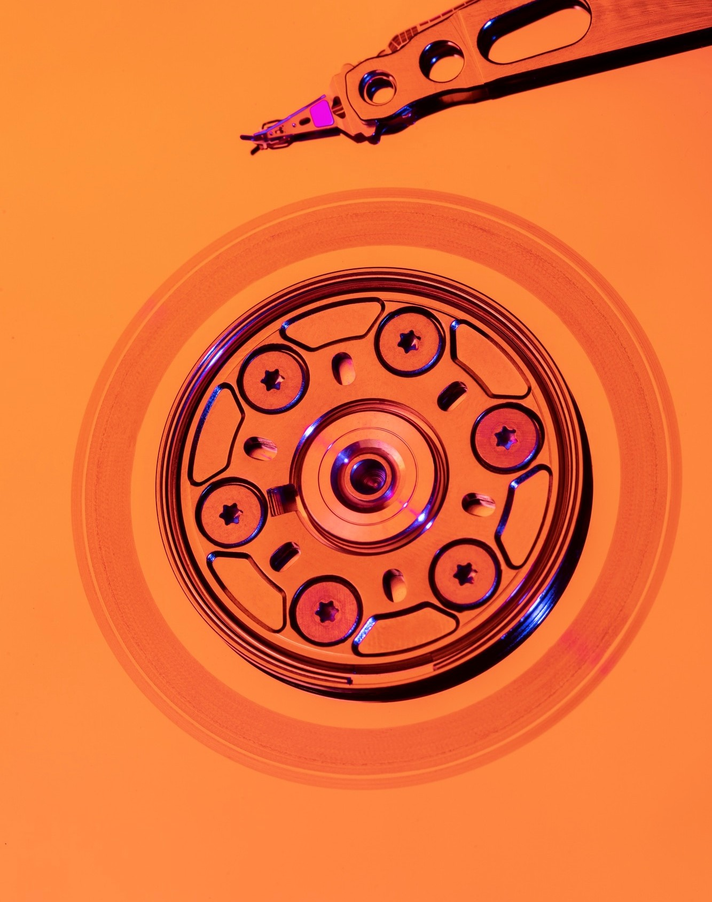
Function Of Cells
Metabolism
Reproduction
Homeostasis
Growth and Development
Response to Stimuli

Slide 4
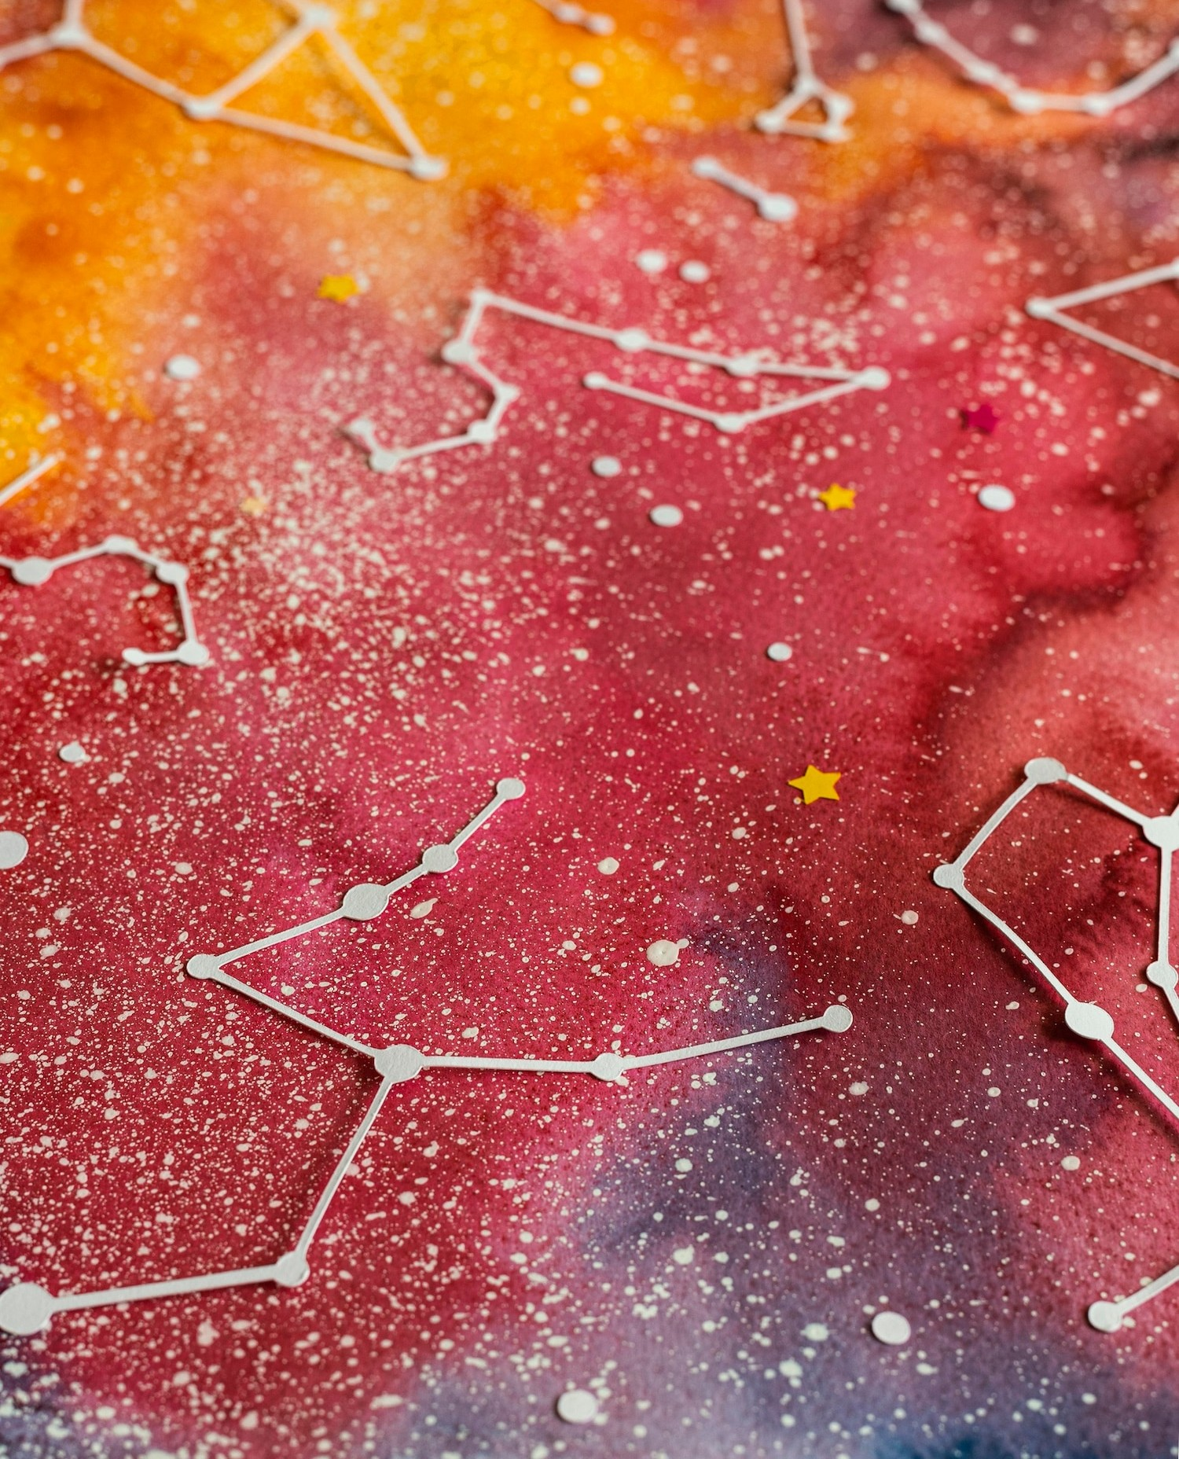
Cell Theory:
The cell theory was given by Matthias Schleidon(1838) and and Theodore Schwaan (1839):
1. All living organisms are composed of cells.
2. The cell is the basic unit of structure and organization in organisms.
3. All cells arise from pre-existing cells.

Slide 5
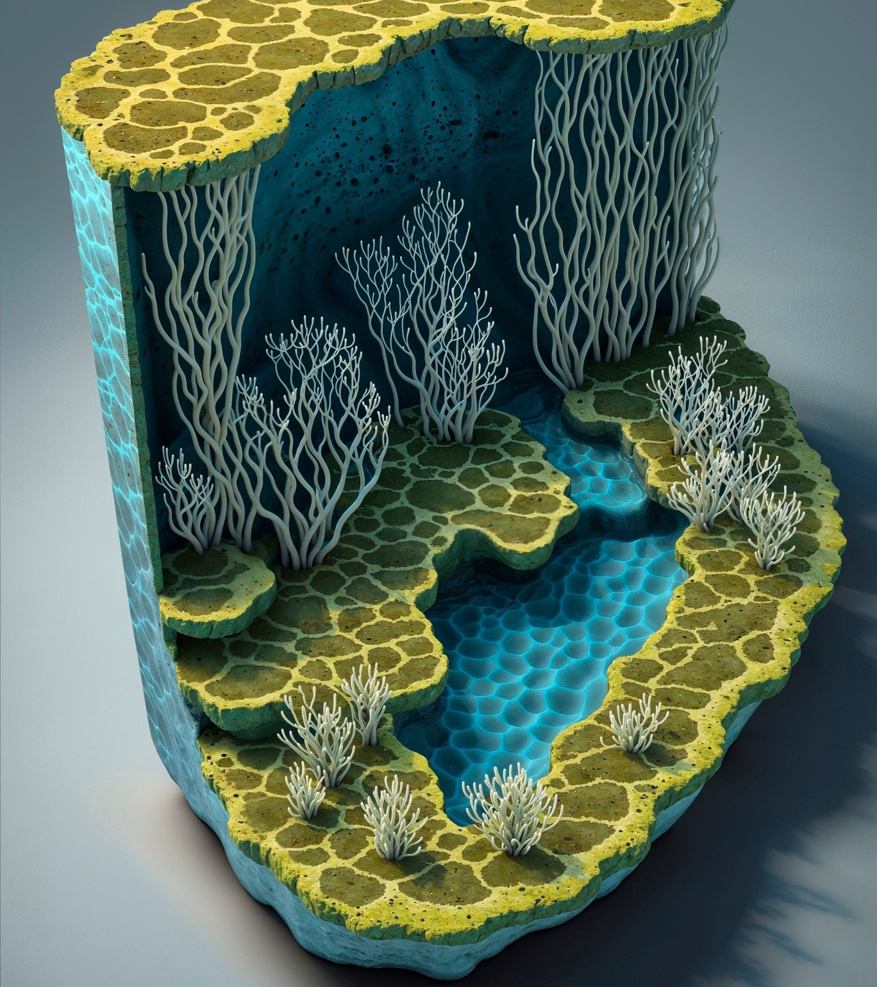
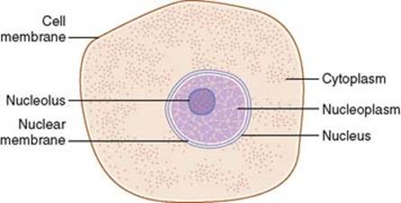
Cell Structure
Cell Membrane: The Outermost layer of the cell is known as Cell membrane. It control the movement of substances in and out of the cells.
Nucleus: The central dense part of cell is known as nucleus. It contains genetic material DNA and RNA.
Cytoplasm: The semi fluid (gel like) between the cell membrane and nucleus is known as cytoplasm. It contains organelles and other cellular components like Ribosomes, Golgi Complex etc.

Slide 6
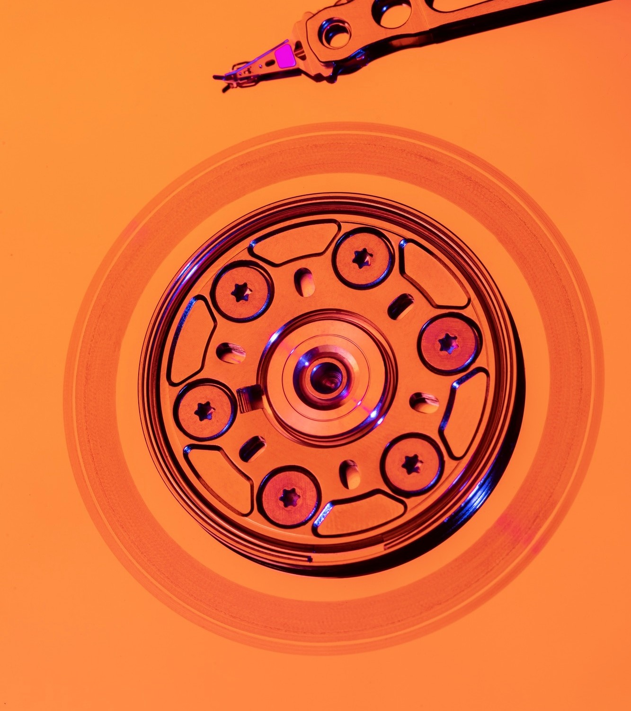
Types Of Cells
Mainly, the cells are of two types:
Prokaryotic cells
Eukaryotic Cells
Prokaryotic Cells:
Prokaryotic cells are simpler and smaller compared to eukaryotic cells and are characteristic of organisms in the domains Bacteria and Archaea.
Eukaryotic Cells:
Eukaryotic cells are more complex and larger than prokaryotic cells, and they are characteristic of organisms in the domains Eukarya, which include animals, plants, fungi, and protists. Eukaryotic cells have a defined nucleus and various membrane-bound organelles that perform specific functions.

Slide 7
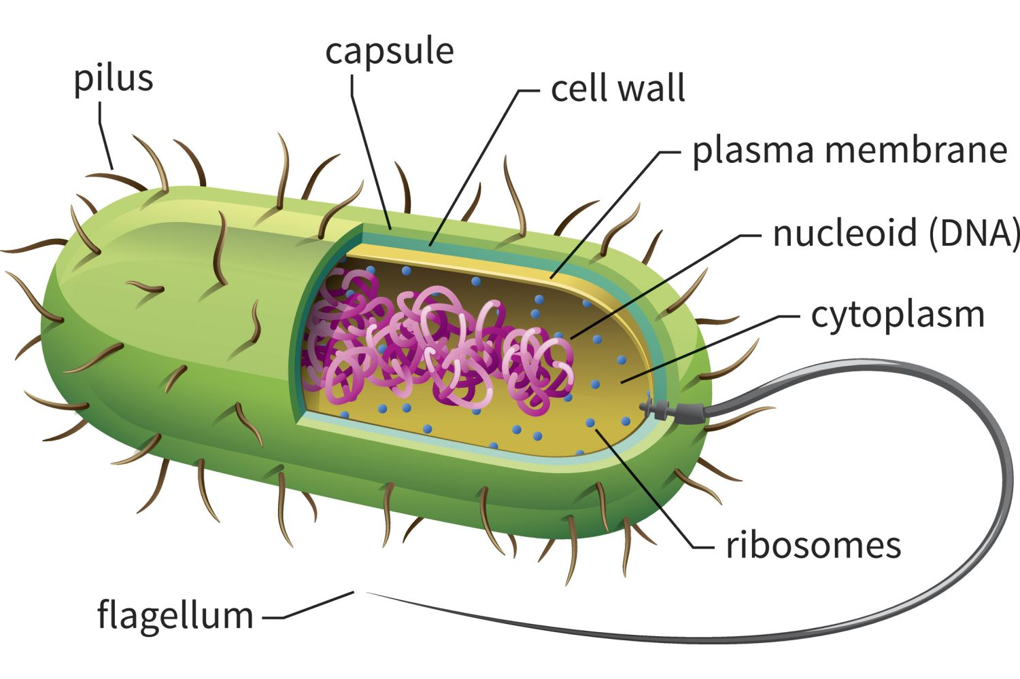
Structure Of Prokaryotic Cells:
Cell Membrane (Plasma Membrane):
  A phospholipid bilayer with embedded proteins that encloses the cell, controlling the movement of substances in and out of the cell.
Cell Wall:
  Provides structural support and protection.
  In bacteria, the cell wall is composed of peptidoglycan (a polymer of sugars and amino acids).
Cytoplasm:
  The gel-like substance inside the cell membrane, excluding the nucleus.
  Contains water, ions, proteins, and other molecules.
  Provides a medium for chemical reactions and houses the cell's internal components.
Nucleoid:
  A region within the cytoplasm where the cell’s DNA is located.
  Unlike eukaryotic cells, prokaryotic cells do not have a membrane-bound nucleus; instead, the DNA is in a single, circular chromosome.
Ribosomes:
  Sites of protein synthesis.
  Composed of RNA and proteins.
  In prokaryotes, ribosomes are smaller (70S) (50S and 30S) compared to eukaryotic ribosomes (80S).

Slide 8
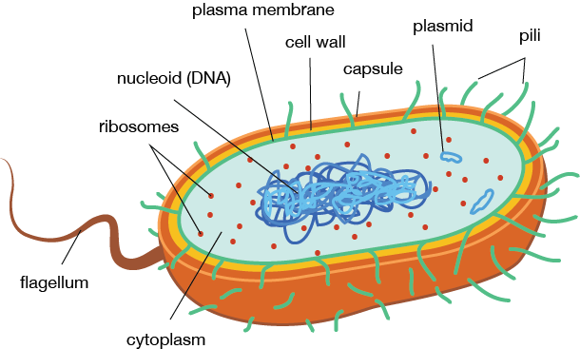
Flagella (if present):
  Long, whip-like structures used for locomotion.
  Prokaryotic flagella are different in structure from eukaryotic flagella and are typically composed of a protein called flagellin.
Pili (or Fimbriae):
  Hair-like projections on the surface of the cell.
  Used for attachment to surfaces and other cells.
  Can also be involved in the transfer of genetic material between cells (conjugation).
Capsule (or Glycocalyx):
  A protective layer outside the cell wall.
  Composed of polysaccharides or proteins.
  Helps the cell evade the immune system and adhere to surfaces.
Plasmids (optional):
  Small, circular DNA molecules separate from the chromosomal DNA.
  Can carry genes that provide an advantage under certain conditions, such as antibiotic resistance.

Slide 9
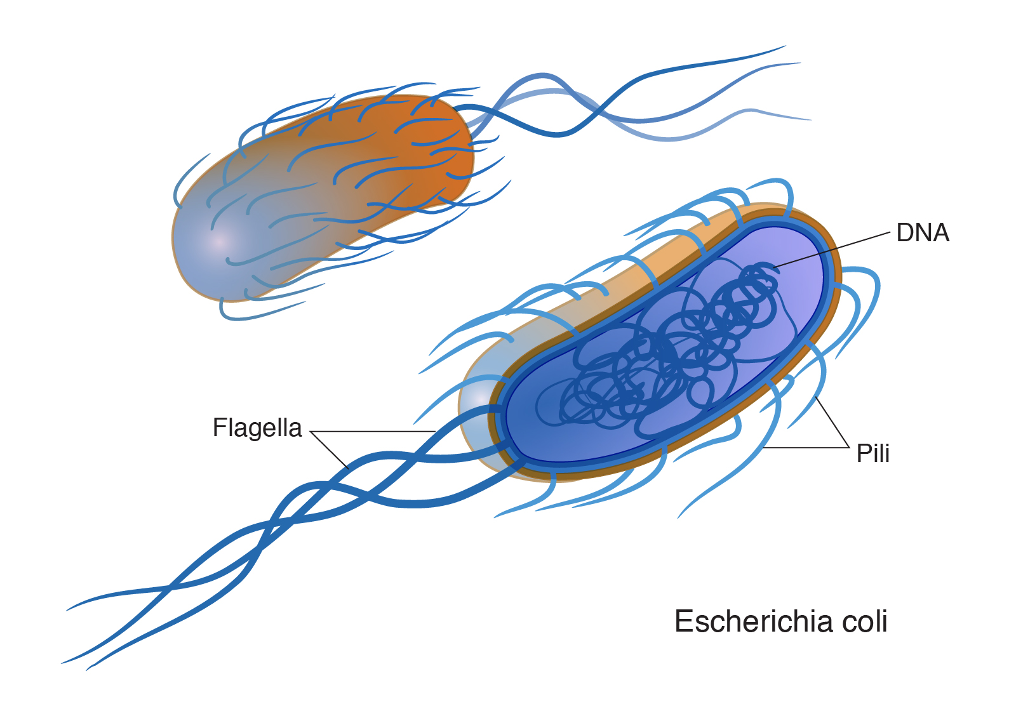
Bacterial Cells
Based on Shape:
  Cocci: Spherical-shaped bacteria (e.g., Staphylococcus, Streptococcus).
  Bacilli: Rod-shaped bacteria (e.g., Escherichia coli, Bacillus anthracis).
  Spirilla: Spiral-shaped bacteria (e.g., Spirillum volutans).
  Vibrios: Comma-shaped bacteria (e.g., Vibrio cholerae).
Based on Gram Staining:
  Gram-Positive Bacteria: Have a thick peptidoglycan layer in their cell walls and retain the crystal violet stain, appearing purple under a microscope (e.g., Staphylococcus aureus).
  Gram-Negative Bacteria: Have a thinner peptidoglycan layer and an outer membrane containing lipopolysaccharides, which prevents retention of the crystal violet stain and turns pink after counterstaining with safranin (e.g., Escherichia coli).
Bacterial Flagella
Bacterial flagella are structures used for motility. They vary in structure and function among different types of bacteria.
Structure:
  Filament: The long, helical part that extends into the environment and is composed of the protein flagellin.
  Hook: A curved structure that connects the filament to the basal body.
  Basal Body: Anchors the flagellum to the cell wall and membrane and acts as a motor.
Types of Flagellar Arrangements:
  Monotrichous: A single flagellum at one end (e.g., Vibrio cholerae).
  Lophotrichous: A cluster of flagella at one or both ends (e.g., Pseudomonas aeruginosa).
  Amphitrichous: Flagella at both ends of the cell (e.g., Campylobacter jejuni).
  Peritrichous: Flagella distributed over the entire surface of the cell (e.g., Escherichia coli).

Slide 10
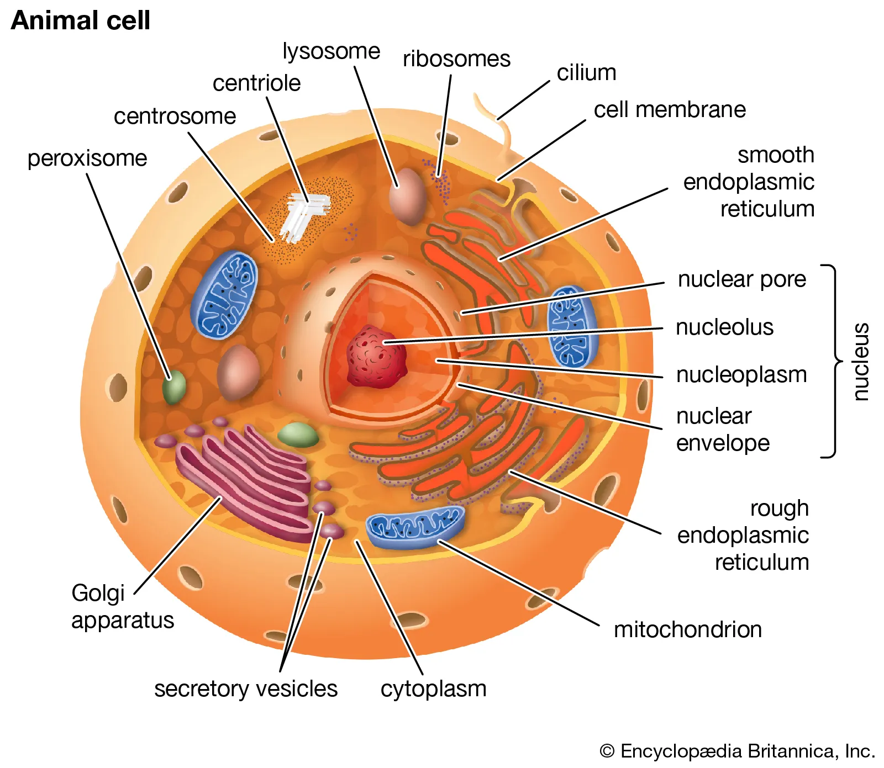
Eukaryotic Cells
Eukaryotic cells are complex and highly organized, distinguished from prokaryotic cells by their internal structure and compartmentalization.
1. Nucleus: Eukaryotic cells have a true nucleus enclosed by a nuclear membrane, where the cell’s genetic material (DNA) is stored and replicated.
2. Organelles: They contain various membrane-bound organelles, each with specific functions:
Mitochondria: The powerhouse of the cell, responsible for generating ATP through cellular respiration.
Endoplasmic Reticulum (ER): There are two types—rough ER (with ribosomes) involved in protein synthesis and smooth ER involved in lipid synthesis and detoxification.
Golgi Apparatus: Modifies, sorts, and packages proteins and lipids for secretion or delivery to other organelles.
Lysosomes: Contain digestive enzymes to break down waste materials and cellular debris.
3. Cytoskeleton: A network of protein fibers (microtubules, microfilaments, and intermediate filaments) that provides structural support, maintains cell shape, and facilitates movement.

Slide 11
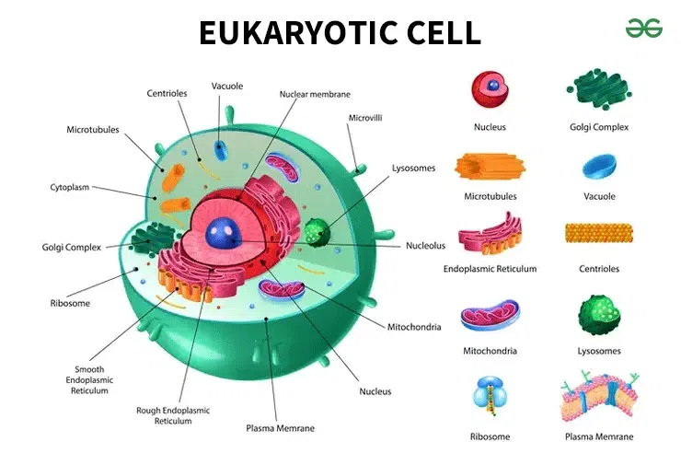
4. Cell Membrane: A phospholipid bilayer with embedded proteins that regulates what enters and leaves the cell and communicates with other cells.
5. Ribosomes: Sites of protein synthesis, found either floating freely in the cytoplasm or attached to the rough ER.
6. Vacuoles: In plant cells, they are large and central, storing nutrients and waste products, and helping to maintain turgor pressure. Animal cells have smaller vacuoles.

Slide 12
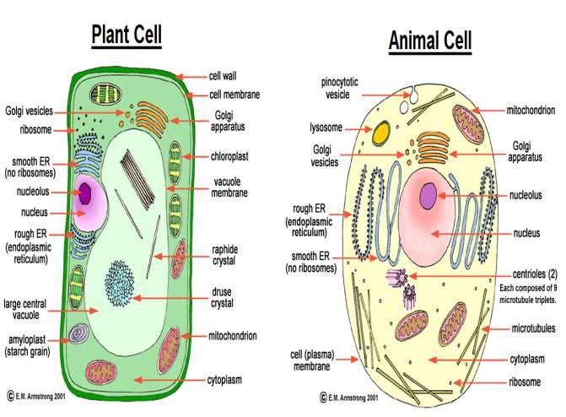

Slide 13
CELL MEMBRANE:
The cell membrane is mainly composed of lipids and proteins.
Major lipids are phospholipids that are arranged in bilayer.
Hydrophilic Heads – towards the outer side (Polar)
Hydrophobic tails towards the inner part. (Non-polar)
Cell membrane also contains proteins and carbohydrates. (In human- 52% protein, 40% lipids)
Proteins –
Integrals Proteins- Partially or totally buried in the membrane
Peripheral proteins – lie on the surface of the membranes
Model of Structure of cell membrane proposed by Sanger and Nicolson (1972) – Fluid Mosaic Model
Phospholipids Bilayer : The cell membrane is composed of a double layer of phospholipids. The hydrophilic (water-attracting) heads face outward, while the hydrophobic (water-repelling) tails face inward, forming a barrier between the inside and outside of the cell.
Fluid Nature : The phospholipids and proteins in the membrane are not static;
Mosaic Proteins : Embedded within the phospholipid bilayer are various proteins (integral and peripheral), which function as channels, carriers, receptors, and enzymes. These proteins are scattered in a "mosaic" pattern.
Glycolipids and Glycoproteins : Carbohydrates are attached to lipids (glycolipids) and proteins (glycoproteins) on the outer surface of the membrane.
Selective Permeability : The membrane is selectively permeable, meaning it allows certain molecules (like gases, water, and small nonpolar molecules) to pass through freely, while regulating the movement of ions and larger molecules.

Slide 14
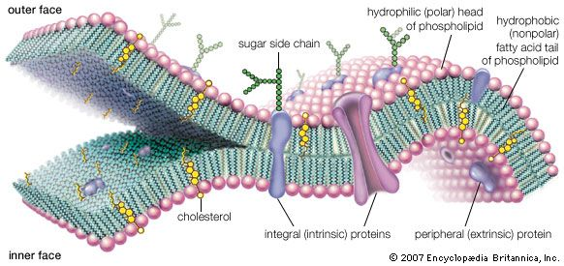




Slide 15
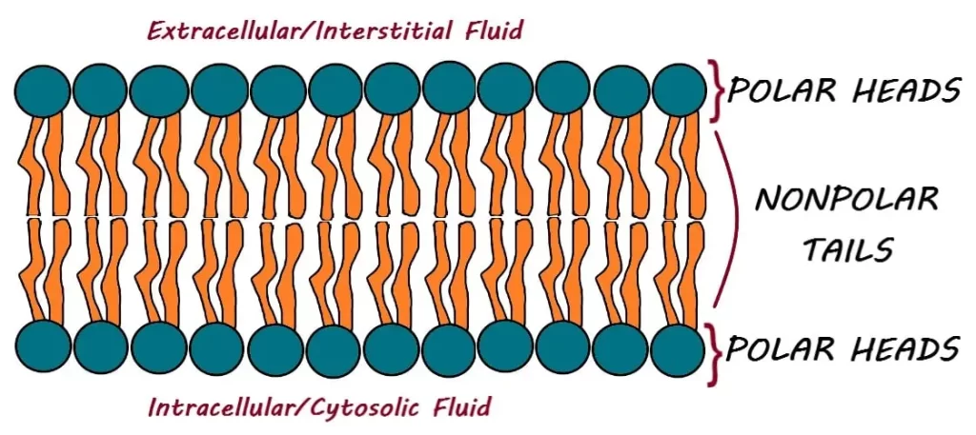

Slide 16
Energy Requirement
Passive Transport: Does not require energy (ATP) to move substances across the cell membrane.
Active Transport: Requires energy (ATP) to move substances against their concentration gradient.
2. Concentration Gradient
Passive Transport: Substances move down their concentration gradient (from an area of high concentration to low concentration).
Active Transport: Substances move against their concentration gradient (from an area of low concentration to high concentration).
3. Types
Passive Transport: Includes diffusion, facilitated diffusion, and osmosis.
Active Transport: Includes primary active transport (direct use of ATP) and secondary active transport (using the electrochemical gradient).
4. Direction of Movement
Passive Transport: Always moves molecules down the concentration gradient (toward equilibrium).
Active Transport: Moves molecules against the concentration gradient (away from equilibrium).
5. Examples
Passive Transport:
  Simple diffusion (e.g., oxygen and carbon dioxide moving across the membrane).
  Facilitated diffusion (e.g., glucose using carrier proteins to enter the cell).
  Osmosis (movement of water through a selectively permeable membrane).
Active Transport:
  Sodium-potassium pump (Na+/K+ pump).
  Endocytosis and exocytosis.
6. Involvement of Proteins
Passive Transport: Sometimes involves channel or carrier proteins (for facilitated diffusion), but these do not require energy.
Active Transport: Always involves carrier proteins or transporters that require energy to function

Slide 17
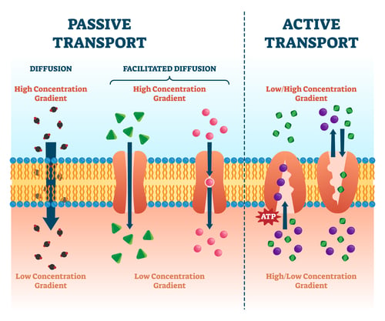

Slide 18
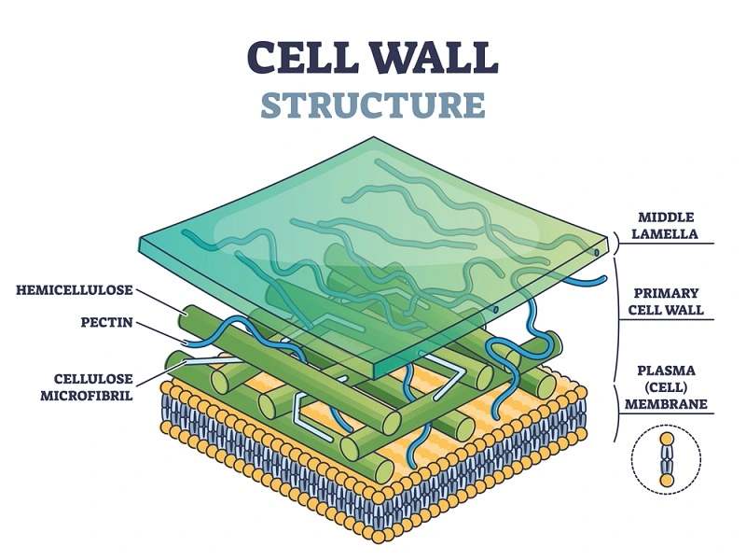
CELL WALL:
A non living rigid structure called as cell wall forms an outer covering for the plasma membrane of fungi and plants.
It not only gives shapes but also provide protection to cell from mechanical damage and infection.
It helps in cell-cell interactions.
Mainly made up of cellulose, hemicellulose, pectin etc.
Primary Cell Wall: Thin and flexible, allowing growth.
Secondary Cell Wall: Thicker, found in mature cells, provides additional strength.
Middle Lamella: Rich in pectin, it helps glue adjacent cells together.
Unlike plants, fungi, and some protists, animal cells lack a cell wall. They only have a flexible cell membrane, allowing for different types of cell shapes and mobility.

Slide 19
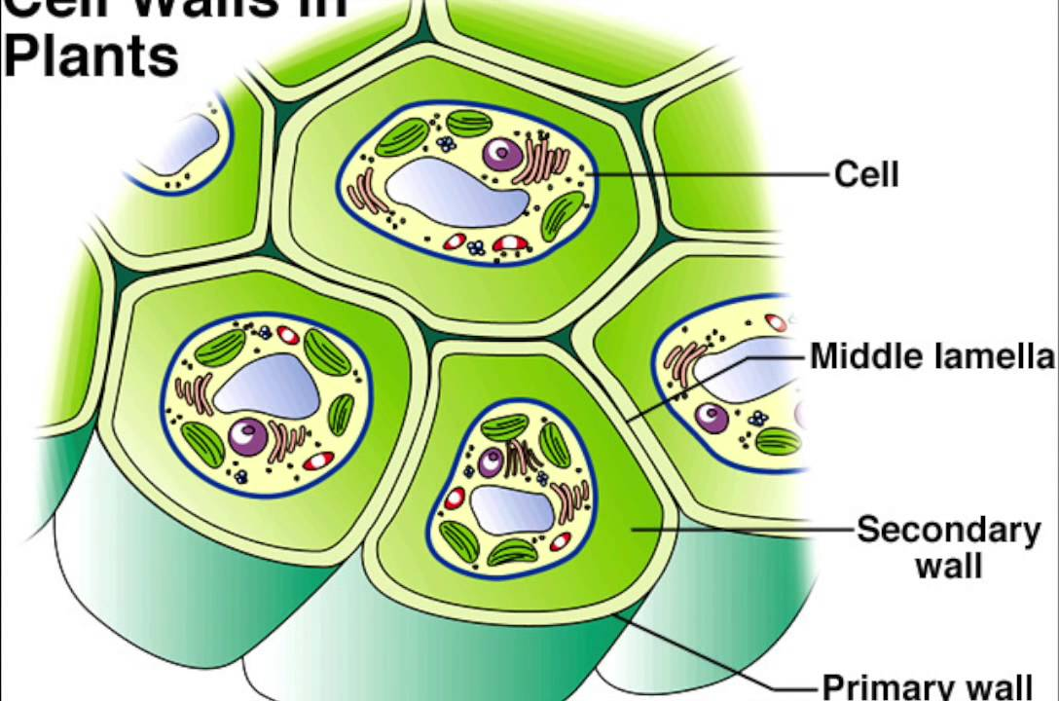

Slide 20
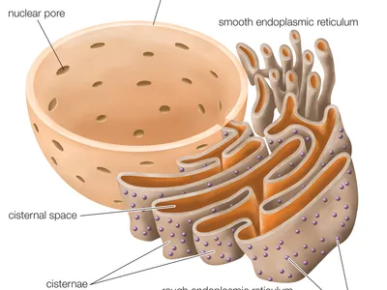
THE ENDOPLASMIC RETICULUM (ER) :
The Endoplasmic Reticulum (ER) is an important organelle in eukaryotic cells involved in the synthesis, folding, modification, and transport of proteins and lipids.
The presence of a network or reticulum of tiny tubular structure scattered in the cytoplasm that is called ER.
ER divide into two compartments:
Luminal (Inside ER)
Extra Luminal (Cytoplasm)
The rough ER is called "rough" because its surface is studded with ribosomes, giving it a granular appearance (RER).
In the absence of ribosomes they appear smooth and are called smooth endoplasmic reticulum (SER).
Protein Synthesis: Ribosomes attached to the RER synthesize proteins that are either secreted by the cell, incorporated into the cell membrane, or sent to lysosomes.
The SER is involved in the synthesis of lipids, including phospholipids and cholesterol, which are essential for membrane formation.
The ER acts as a manufacturing and packaging system within the cell. It synthesizes proteins and lipids, ensures proper protein folding, detoxifies harmful substances, and transports synthesized molecules to their destinations, often in collaboration with the Golgi apparatus.

Slide 21
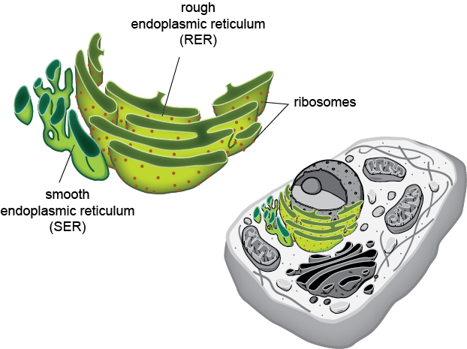

Slide 22
GOLGI APPARATUS:
Camilio Golgi (1898) first observed densely stained reticular structure near the nucleus.
These were stacked parallel to each other.
Structure:
  Consists of a series of flattened, membrane-bound sacs called cisternae.
  Has two distinct faces: cis face (receiving side) and trans face (shipping side).
  Vesicles from the endoplasmic reticulum fuse with the cis face, while vesicles from the trans face carry processed proteins to other locations.
Functions:
  Modification of proteins: Glycosylation (adding carbohydrate groups) and other post-translational modifications.
  Packaging and sorting: Proteins and lipids are packaged into vesicles for transport to specific destinations (like lysosomes or the plasma membrane).
  Formation of lysosomes.
  Secretion: Involved in the secretion of enzymes, hormones, and other materials.

Slide 23
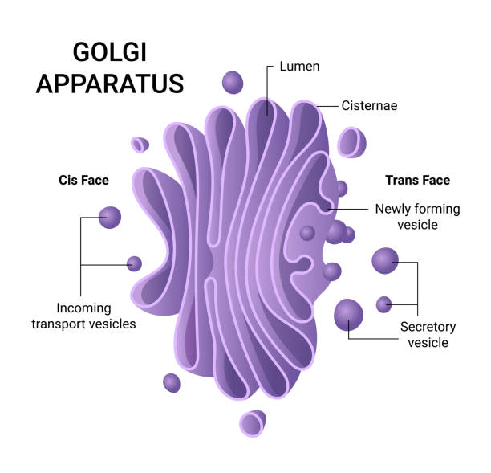

Slide 24
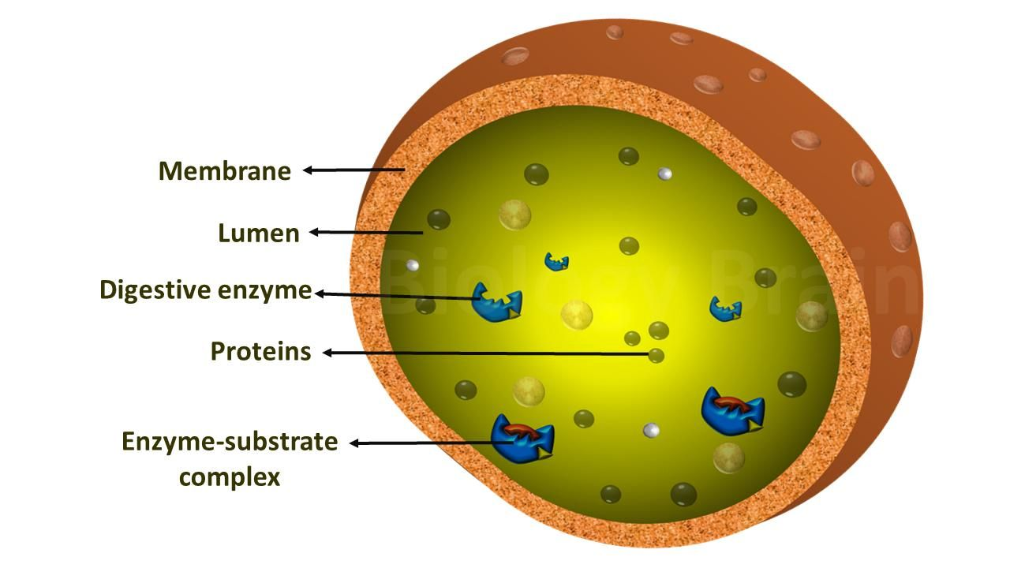
LYSOSOMES:
Structure:
  Small, spherical, membrane-bound organelles filled with digestive enzymes.
  Acidic pH inside due to proton pumps in the membrane.
Functions:
  Intracellular digestion: Breaks down macromolecules (proteins, lipids, carbohydrates, and nucleic acids).
  Autophagy: Digests damaged organelles, recycling cellular components.
  Défense against pathogens: Can digest bacteria and viruses.
  Apoptosis (programmed cell death): Lysosomes play a role in the destruction of the cell by releasing their enzymes.

Slide 25
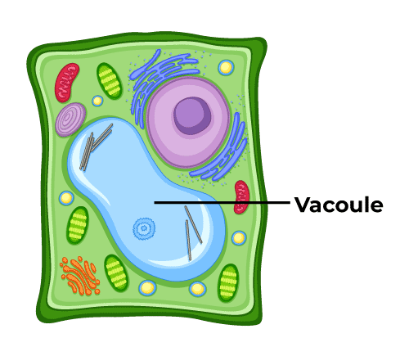
VACUOLES:
Structure:
  Membrane-bound sacs filled with water, ions, and other solutes.
  In plant cells, the central vacuole is large and occupies most of the cell’s volume.
Functions:
  Storage: Stores nutrients, waste products, ions, and other substances.
  Turgor pressure: In plant cells, the central vacuole maintains turgor pressure, which helps the plant maintain its structure.
  Osmoregulation: In freshwater organisms, contractile vacuoles expel excess water to maintain osmotic balance.
  Isolates harmful substances.

Slide 26
MITOCHONDRIA:
Mitochondria are double-membrane-bound cell organelles found in the cytoplasm of eukaryotic cells. They are often referred to as the "powerhouse of the cell" because they generate most of the cell’s supply of adenosine triphosphate (ATP), the energy currency of the cell.
Structure of Mitochondria:
Outer Membrane:
  Smooth and porous.
  Contains proteins called porins that allow the passage of ions and small molecules.
Intermembrane Space:
  The space between the outer and inner membranes.
  This space is important for the generation of ATP, as it accumulates protons pumped from the matrix.
Inner Membrane:
  Highly folded into structures called cristae.
  Contains the proteins and enzymes involved in the electron transport chain and ATP synthesis.
  Less permeable than the outer membrane and maintains the electrochemical gradient.
Matrix:
  The innermost part of the mitochondrion, enclosed by the inner membrane.
  Contains mitochondrial DNA, ribosomes, enzymes involved in the citric acid cycle (Krebs cycle), and other metabolic processes.
Cristae:
  The folds of the inner membrane that increase the surface area for chemical reactions.
  More cristae allow for greater ATP production.
Functions:
ATP Productions
Regulation of cellular metabolism

Slide 27
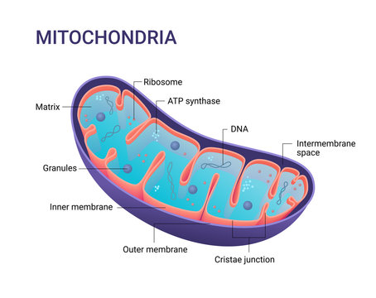

Slide 28
PLASTIDS:
Plastids are double-membrane-bound organelles found in the cells of plants and algae. They play a crucial role in the synthesis and storage of food, as well as in the process of photosynthesis. Plastids are unique to plant cells and come in different forms based on their function.
Types of Plastids:
Chloroplasts (Green Plastids)
Chromoplasts (Colored Plastids)
Leucoplasts (Colorless Plastids)
Chloroplasts:
Function:
  Chloroplasts are responsible for photosynthesis, the process by which plants convert light energy into chemical energy (glucose).
  They contain the pigment chlorophyll, which captures light energy.
  Produce oxygen as a byproduct of photosynthesis.
Structure:
Outer Membrane: Smooth and permeable to small molecules and ions.
Inner Membrane: Less permeable, regulates the passage of substances in and out of the chloroplast.
Stroma: The fluid-filled space inside the chloroplast. Contains enzymes for the Calvin cycle (light-independent reactions of photosynthesis).
Thylakoids: Flattened membrane sacs that contain chlorophyll. The light-dependent reactions of photosynthesis occur here.
Grana: Stacks of thylakoids. They increase the surface area for photosynthetic reactions.
DNA and Ribosomes: Chloroplasts have their own DNA (circular) and ribosomes, similar to mitochondria, supporting the endosymbiotic theory.

Slide 29
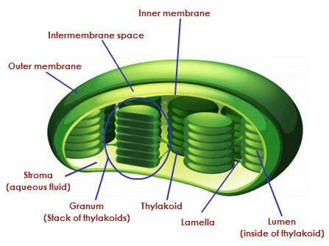
Chromoplasts:
Function:
  Chromoplasts are involved in the synthesis and storage of pigments that give color to flowers, fruits, and aging leaves.
  They contain carotenoids (yellow, orange, red pigments) that attract pollinators or seed dispersers.
Structure:
  Chromoplasts contain a variety of pigments, mainly carotenoids.
  They may develop from chloroplasts as fruits ripen (e.g., when green fruits turn red or orange).
Leucoplasts:
Function:
  Leucoplasts are colorless plastids that function mainly in the storage of nutrients such as starch, oils, and proteins.
  Function:
  Photosynthesis
  Storage of food
  Pigment Synthesis
Types of Leucoplasts:
Amyloplasts: Store starch (e.g., in potato tubers).
Elaioplasts: Store lipids.
Proteinoplasts: Store proteins.

Slide 30
RIBOSOMES:
Ribosomes are small, dense, and spherical organelles composed of ribonucleic acid (RNA) and proteins. They are the site of protein synthesis in all living cells, translating genetic information from messenger RNA (mRNA) into proteins. Ribosomes can be found in both prokaryotic and eukaryotic cells, either floating freely in the cytoplasm or attached to the endoplasmic reticulum.
Structure of Ribosomes:
Ribosomes are made up of two subunits:
Small Subunit:
Binds to the mRNA.
Reads the mRNA sequence during translation.
Large Subunit:
Contains the sites where amino acids are assembled into a polypeptide chain.
The large subunit has two important sites:
    A site (Aminoacyl site): Where the incoming amino acid-tRNA complex binds.
    P site (Peptidyl site): Where the growing polypeptide chain is held.
    E site (Exit site): Where the tRNA, after delivering its amino acid, exits the ribosome.
Ribosomes are measured by their sedimentation coefficient (S), which indicates their size and density.
Prokaryotic Ribosomes: Eukaryotic Ribosomes:
70S ribosomes, composed of: 80S ribosomes, composed of:
    50S (large subunit) 60S (large subunit)
    30S (small subunit) 40S (small subunit)

Slide 31
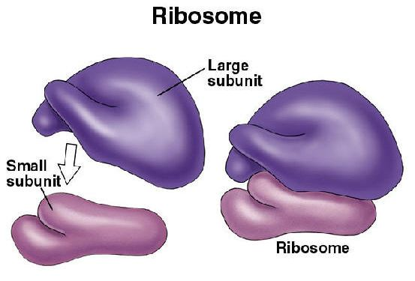
Location of Ribosomes:
Free Ribosomes:
  Found floating in the cytoplasm.
  Synthesize proteins that function within the cytoplasm itself.
Bound Ribosomes:
  Attached to the rough endoplasmic reticulum (RER) or the nuclear envelope.
  Synthesize proteins that are destined for secretion, insertion into membranes, or lysosomes.
  Functions:
  Protein Synthesis
  Gene Expression
  Support Cellular Functions

Slide 32
CYTOSKELETON:
The cytoskeleton is a network of protein fibers found in the cytoplasm of eukaryotic cells. It provides structural support, maintains cell shape, facilitates intracellular transport, and aids in various cellular movements.
Components of the Cytoskeleton:
The cytoskeleton is composed of three main types of protein filaments:
Microfilaments (Actin Filaments)
Intermediate Filaments
Microtubules
Functions of the Cytoskeleton:
Maintaining Cell Shape:
  The cytoskeleton provides mechanical support to the cell, helping it maintain its shape, especially in animal cells that lack a cell wall.
Intracellular Transport:
  The cytoskeleton acts as a network of tracks for the transport of organelles, vesicles, and other materials within the cell. Microtubules and microfilaments play a key role in this process.
Cell Motility:
  The cytoskeleton enables cells to move. Microfilaments are involved in amoeboid movement, while microtubules power the movement of cilia and flagella.
Cell Division:
  The cytoskeleton, particularly microtubules, is essential for the proper alignment and separation of chromosomes during cell division. The mitotic spindle, made of microtubules, ensures that each daughter cell receives the correct number of chromosomes.
Mechanical Support:
  Intermediate filaments provide tensile strength to cells, allowing them to resist mechanical stress and maintain their integrity.
Signal Transmission:
  The cytoskeleton is involved in transmitting signals from the cell surface to the interior, helping the cell respond to external stimuli.

Slide 33
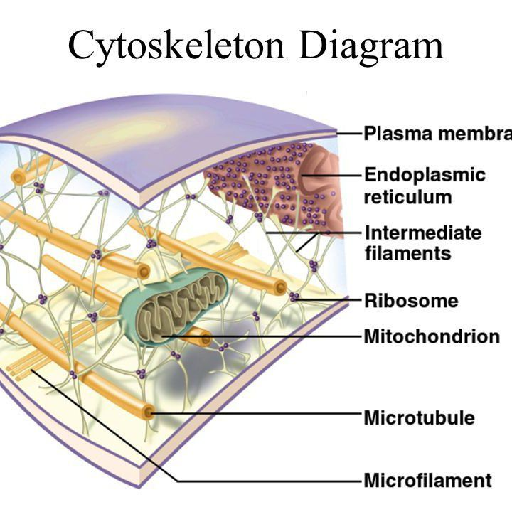

Slide 34
CILIA AND FLAGELLA:
Cilia and flagella are hair-like, motile structures that extend from the surface of some eukaryotic cells. Both are involved in movement, but their structure and functions differ slightly. Cilia are usually shorter and more numerous, while flagella are longer and fewer in number. These structures are responsible for either moving the entire cell or moving substances across the surface of the cell.
Structure of Cilia and Flagella:
Common Structure:
Both cilia and flagella share a similar internal structure. They are made up of microtubules arranged in a characteristic "9+2" pattern:
    Axoneme: The core of cilia and flagella is called the axoneme, which consists of nine pairs (doublets) of microtubules arranged in a ring around two central microtubules.
    Basal Body: At the base of each cilium or flagellum is the basal body, which is structurally similar to a centriole. The basal body anchors the cilium or flagellum to the cell and initiates its growth.
    Dynein Arms: Dynein is a motor protein attached to the microtubule doublets. It is responsible for generating the sliding motion between microtubules, leading to the bending of the cilium or flagellum.
Differences:
  Cilia:
    Short, numerous, and typically present on the entire surface of the cell.
    Have a beating motion similar to the movement of oars, moving substances in a coordinated, wave-like pattern.
  Flagella:
    Longer and fewer in number (usually one or two per cell).
    Move in a whip-like or undulating motion, propelling the cell through its environment.

Slide 35
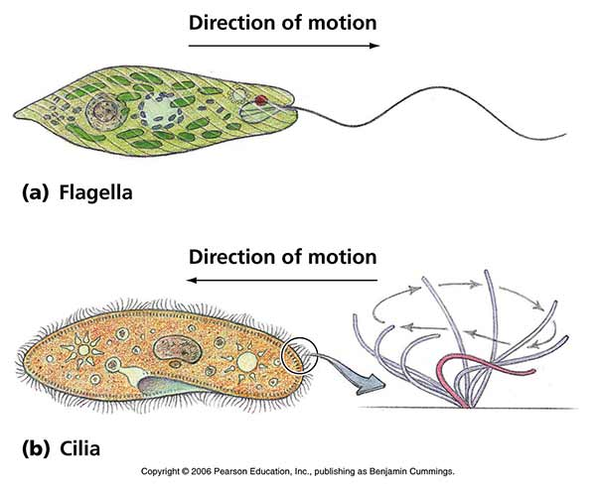
Types of Cilia:
Motile Cilia:
  These are the type of cilia that are involved in movement and found in large numbers on the surface of cells (e.g., respiratory tract cilia).
Non-motile Cilia (Primary Cilia):
  These cilia are typically present as a single structure per cell and act as sensory organelles, not involved in movement.
Importance of Cilia and Flagella:
Cell Movement and Transport: Cilia and flagella play a vital role in cell movement (flagella in sperm) and the movement of substances (cilia in the respiratory tract).
Sensory Functions: Primary cilia help cells sense environmental signals and are involved in several cellular processes like cell cycle regulation and development.

Slide 36
CENTROSOMES AND CENTRIOLES:
Centrosomes and centrioles are crucial components of a cell's microtubule organizing center, playing key roles in cell division and the organization of the cell's cytoskeleton.
The centrosome is a structure in animal cells that serves as the main microtubule organizing center (MTOC). It plays a crucial role in organizing microtubules, regulating the cell cycle, and forming the mitotic spindle during cell division.
Structure:
Location:
  The centrosome is typically located near the nucleus in animal cells.
Composition:
  The centrosome consists of two centrioles positioned at right angles to each other and surrounded by an amorphous mass of protein known as the pericentriolar material (PCM).
  The PCM contains proteins responsible for nucleating and anchoring microtubules.
  Centrioles are cylindrical structures composed of microtubules that are found within the centrosome. They play a critical role in the formation of the spindle fibers during cell division, the organization of microtubules, and the formation of cilia and flagella.
Structure:
Microtubule Arrangement:
  Each centriole is composed of nine triplets of microtubules arranged in a circular pattern. These triplets form the walls of the cylindrical structure.
Size:
  Centrioles are about 0.3–0.5 micrometers in length and 0.15 micrometers in diameter.
Centrioles Occur in Pairs:
  In the centrosome, centrioles are found as a pair of structures positioned at right angles to each other. This pair is referred to as a diplosome.

Slide 37
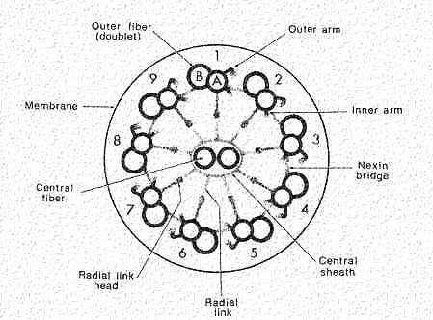
Importance of Centrosomes and Centrioles:
Chromosome Segregation:
  Centrosomes are critical for the accurate segregation of chromosomes during mitosis and meiosis. Errors in this process can lead to abnormal numbers of chromosomes in daughter cells, a condition known as aneuploidy, which is often associated with cancer.
Cellular Organization:
  Centrosomes ensure that the cell's cytoskeleton is properly organized, which is important for maintaining cell shape, intracellular transport, and positioning of organelles.
Cilia and Flagella Formation:
  Centrioles, through their transformation into basal bodies, are vital for the formation of cilia and flagella. Cilia and flagella are essential for cellular motility and moving substances across the surface of cells (e.g., in the respiratory tract).

Slide 38
NUCLEUS:
The nucleus is a vital organelle in eukaryotic cells, controlling cellular activities and housing genetic material.
First described by Robert Brown (1831).
Structure of the Nucleus:
Nuclear Envelope:
  It is a double membrane that surrounds the nucleus.
  The outer membrane is continuous with the endoplasmic reticulum, often studded with ribosomes.
  The space between the membranes is called the perinuclear space.
  Nuclear pores regulate the transport of materials (like RNA and proteins) in and out of the nucleus.
Nucleoplasm:
  A semi-fluid matrix inside the nucleus, similar to cytoplasm.
  Contains chromatin and the nucleolus.
Chromatin:
  Made of DNA and proteins (histones).
  Exists in two forms:
    Euchromatin: Less condensed, transcriptionally active. (present at center)
    Heterochromatin: More condensed, transcriptionally inactive. (present at peripheral)
  During cell division, chromatin condenses to form chromosomes.
Nucleolus:
  A dense, non-membrane-bound structure involved in ribosome synthesis.
  It assembles ribosomal RNA (rRNA) and combines it with proteins to form ribosomal subunits.

Slide 39
Functions of the Nucleus:
Storage of Genetic Information:
  The nucleus contains the cell’s DNA, which carries genetic information for growth, metabolism, and reproduction.
Gene Expression and Regulation:
  It regulates gene expression by controlling transcription (the process where DNA is copied into RNA).
  The nucleus also regulates the production of mRNA, which is then translated into proteins in the cytoplasm.
Cell Division:
  The nucleus plays a crucial role during cell division, ensuring the proper distribution of genetic material between daughter cells.
  It goes through phases of the cell cycle, including interphase (where the chromatin is diffused and DNA is replicated) and mitosis/meiosis (where chromosomes are segregated into daughter cells).
Ribosome Production:
  The nucleolus within the nucleus is the site of ribosomal RNA synthesis and ribosome subunit assembly.
Nucleocytoplasmic Transport:
  The nuclear pores regulate the movement of molecules between the nucleus and cytoplasm, ensuring communication between the two regions.
Nucleus in Prokaryotes vs. Eukaryotes:
Prokaryotes: Lack a true nucleus; their genetic material is found in a region called the nucleoid.
Eukaryotes: Have a well-defined, membrane-bound nucleus, which is essential for compartmentalizing genetic material and processes.

Slide 40
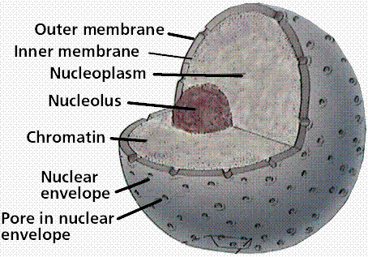
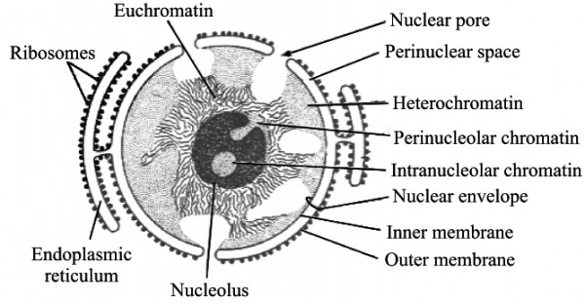

Slide 41
CHROMOSOMES:
Chromosomes are thread-like structures composed of DNA and proteins that carry genetic information. They play a crucial role in heredity, cell division, and the regulation of gene expression.
Structure of Chromosomes:
DNA:
  Chromosomes are made of a long, continuous thread of DNA.
  The DNA in chromosomes is organized into genes, which are sequences that encode proteins.
Histones:
  The DNA in chromosomes is wrapped around proteins called histones.
  This forms structures called nucleosomes, which allow the DNA to be tightly packed inside the nucleus.
Chromatin:
  Chromatin is the material that makes up chromosomes. It consists of DNA and histone proteins.
  Chromatin exists in two forms:
    Euchromatin: Loosely packed, accessible for transcription (active form).
    Heterochromatin: Densely packed, mostly inactive in transcription.
Chromatids:
  During cell division, chromosomes consist of two identical strands called sister chromatids, which are joined at a region called the centromere.
  Each chromatid carries identical genetic information, and they are separated during cell division to ensure that each daughter cell gets an identical set of chromosomes.
Centromere:
  The centromere is the region where two sister chromatids are joined together.
Telomeres:
  Telomeres are repetitive sequences of DNA located at the ends of chromosomes.
  They protect the ends of chromosomes from deterioration and prevent them from sticking to each other.

Slide 42
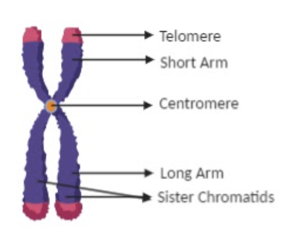
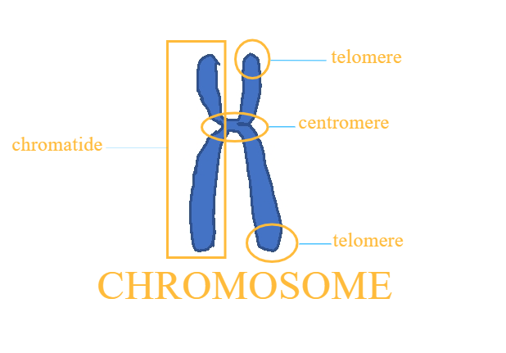

Slide 43
Chromosomes can be classified into different types based on several criteria, such as their structure, function, and number.
Based on the Position of the Centromere:
1. Metacentric Chromosomes:
The centromere is located in the middle, creating two arms of equal length.
These chromosomes appear V-shaped during anaphase.
2. Submetacentric Chromosomes:
The centromere is slightly off-center, resulting in one arm being slightly longer than the other.
They appear L-shaped during anaphase.
3. Acrocentric Chromosomes:
The centromere is located near one end, making one arm very short and the other arm long.
These chromosomes appear J-shaped during anaphase.
4. Telocentric Chromosomes:
The centromere is at the very end of the chromosome, so it has only one arm.
These chromosomes are not present in humans but are found in other organisms, like mice.

Slide 44
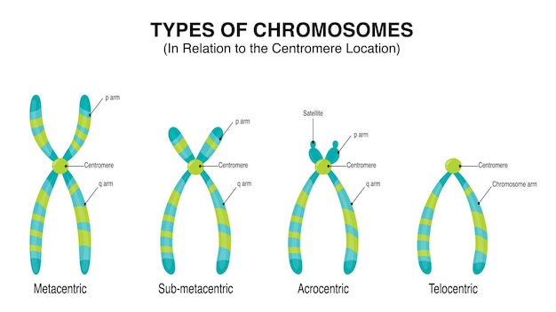

Slide 45
Based on Function:
Chromosomes can also be classified according to their function:
1. Autosomes:
  These are the non-sex chromosomes that carry genetic information for most of the body’s traits and functions.
  Humans have 22 pairs of autosomes (44 chromosomes in total).
  These chromosomes are involved in determining general characteristics like hair color, height, etc.
2. Sex Chromosomes (Allosomes):
  These determine the sex of an individual and carry genes related to sex determination and some sex-linked traits.
  In humans, there are two sex chromosomes:
    X Chromosome: Present in both males and females (females have two X chromosomes, males have one).
    Y Chromosome: Present only in males (males have one Y chromosome paired with one X chromosome).
  Females are XX, and males are XY.

Slide 46
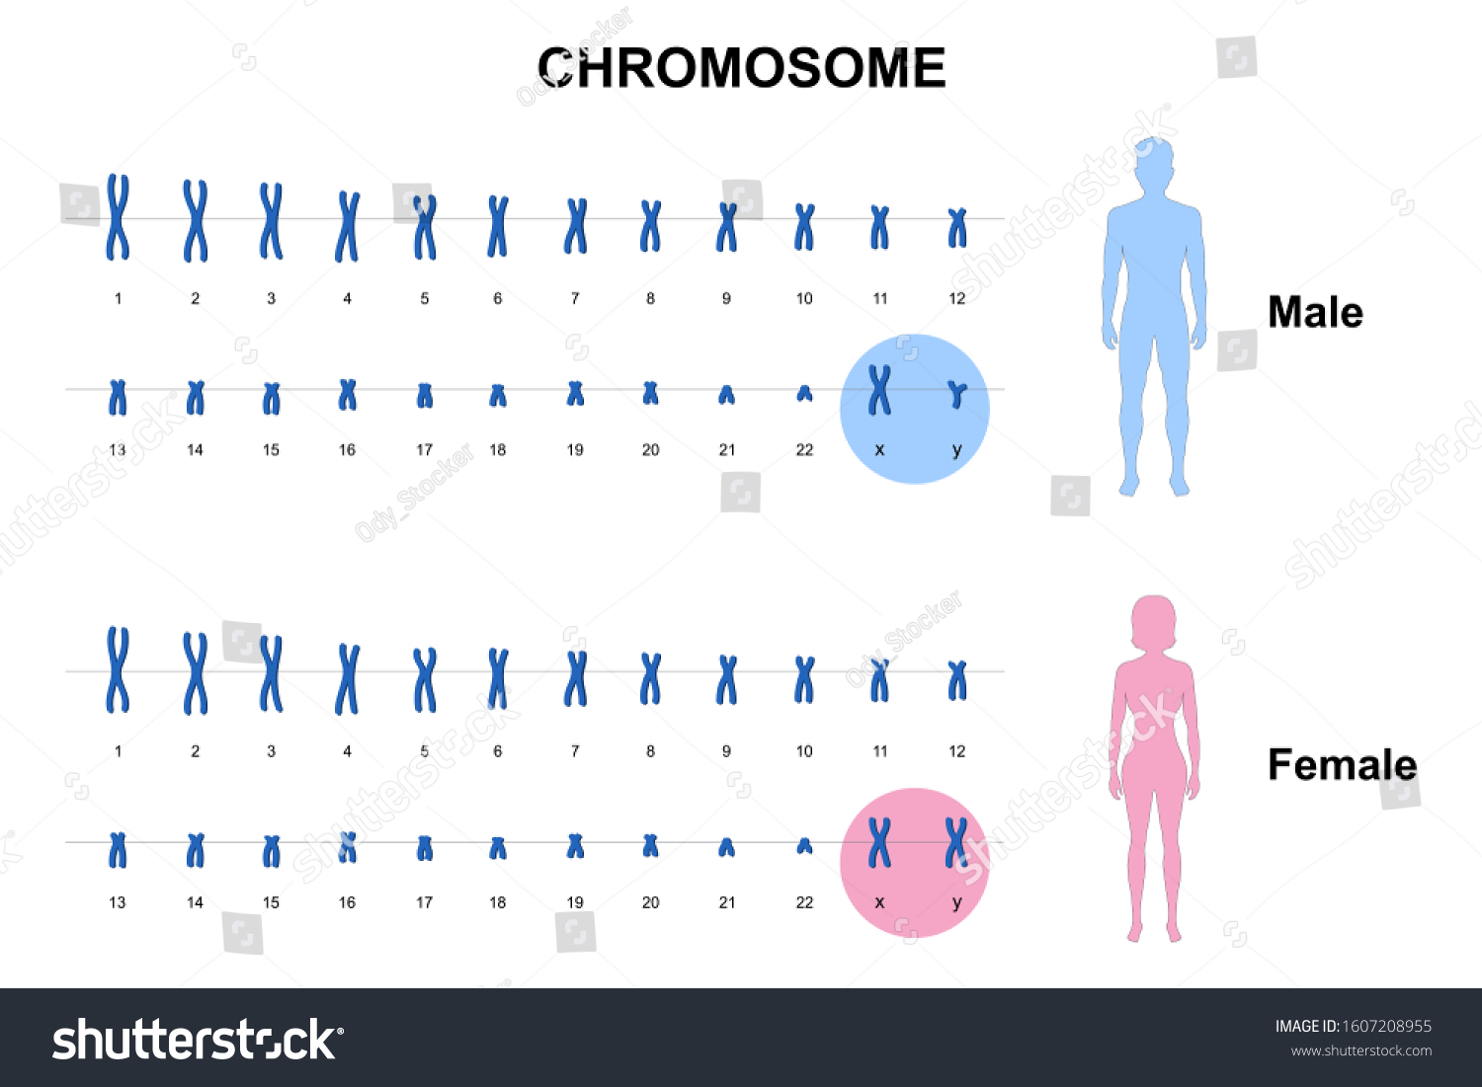

Slide 47
Based on Chromosome Number (in a cell):
Diploid (2n):
  Cells with two sets of chromosomes, one from each parent.
  Most body (somatic) cells are diploid.
  In humans, the diploid number is 46 (23 pairs of chromosomes).
Haploid (n):
  Cells with one set of chromosomes, typically found in gametes (sperm and egg cells).
  Haploid cells have half the number of chromosomes as diploid cells.
  In humans, the haploid number is 23 (one chromosome from each pair).
Polyploid:
  Cells or organisms that have more than two complete sets of chromosomes.
  Polyploidy is common in plants, where organisms can be triploid (3n), tetraploid (4n), or even higher.

Slide 48
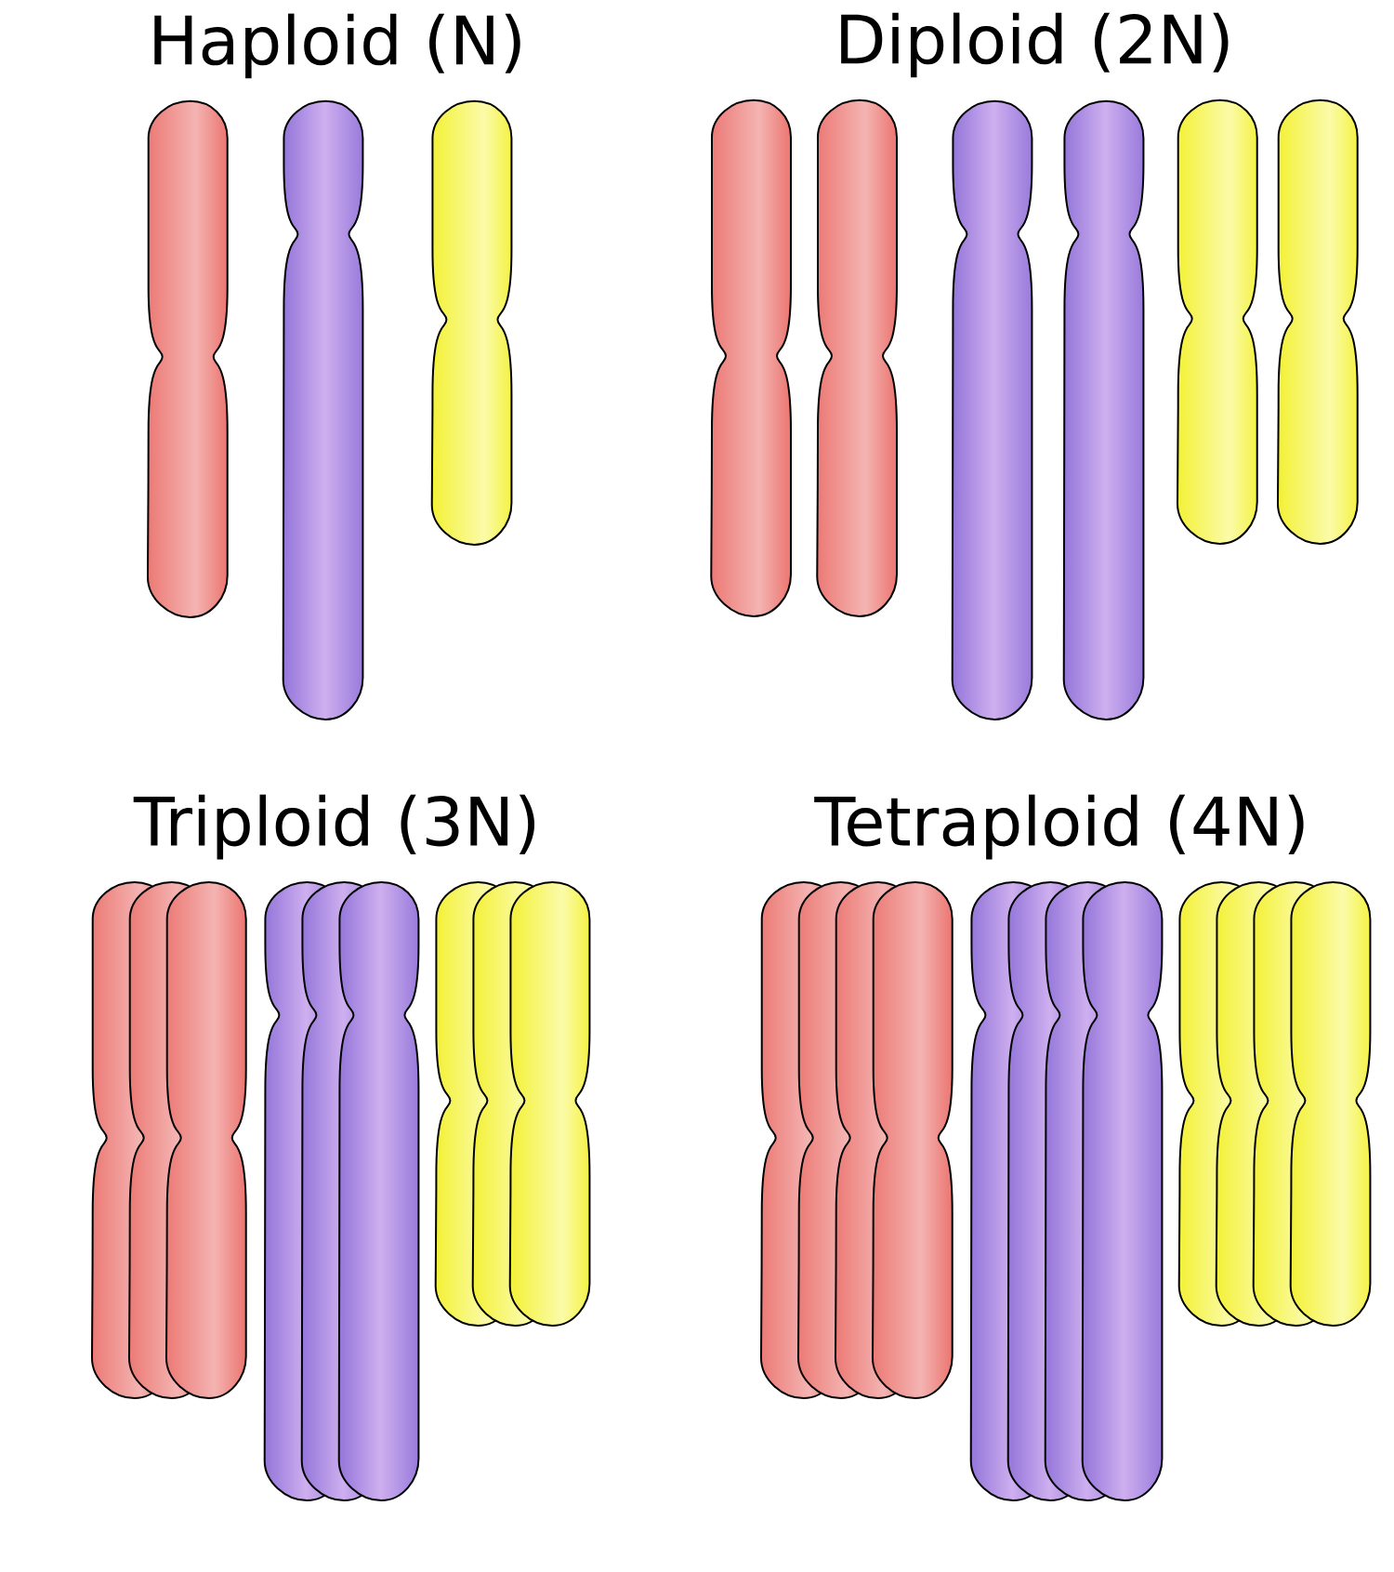

Slide 49
Based on Chromosome Behavior during Cell Division:
Somatic Chromosomes:
  These chromosomes are present in somatic (body) cells and undergo mitosis.
  They are diploid (2n) in nature, ensuring that daughter cells receive identical sets of chromosomes after cell division.
  Example: Human skin or liver cells.
Germline Chromosomes:
  These chromosomes are present in germ cells (gametes) and undergo meiosis to produce haploid cells.
  They are responsible for passing genetic material to offspring.
  Example: Sperm and egg cells.

Slide 50
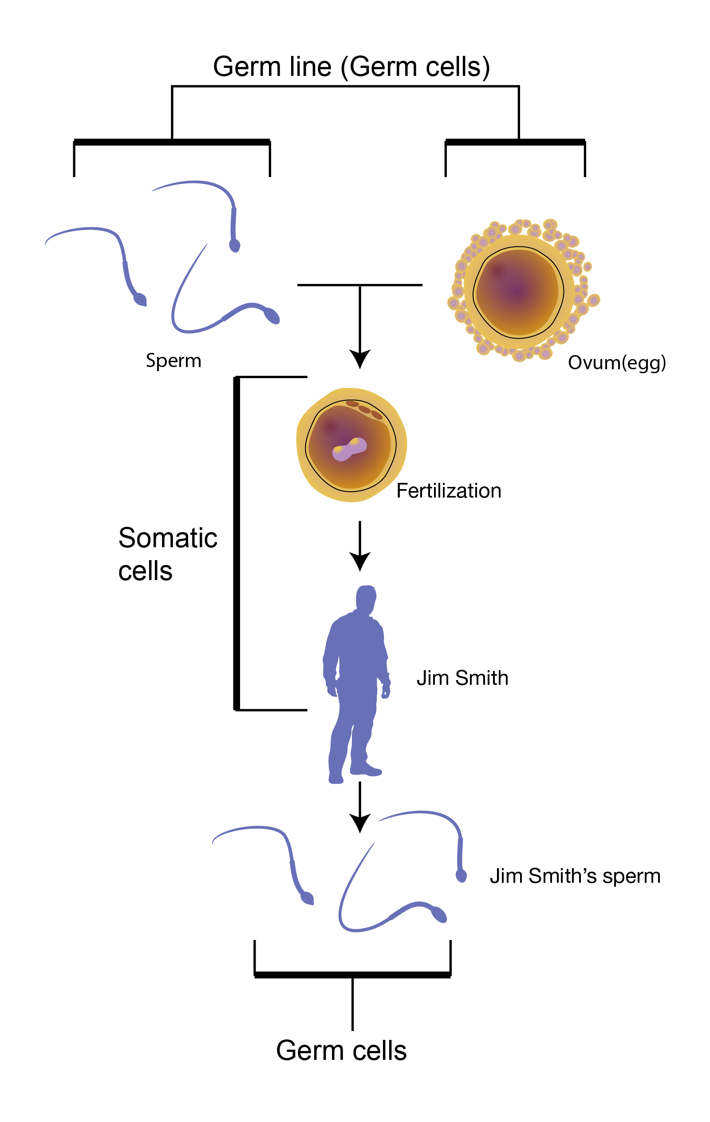

Slide 51
MICROBODIES:
Microbodies are small, membrane-bound organelles found in the cytoplasm of eukaryotic cells. They are involved in various metabolic activities, particularly those related to the breakdown of fats and the detoxification of harmful substances. Microbodies include peroxisomes and glyoxysomes, and they play a crucial role in cellular metabolism.
Types of Microbodies:
Peroxisomes:
  Found in almost all eukaryotic cells, peroxisomes are involved in the detoxification of harmful substances and the breakdown of fatty acids.
Glyoxysomes:
Found primarily in plant cells and some fungi, especially in the seeds of oil-rich plants, glyoxysomes are specialized peroxisomes involved in converting stored fats into carbohydrates.
Functions:
Peroxisomes are responsible for fatty acid oxidation and detoxification, while glyoxysomes are involved in converting fats to sugars during seed germination.
They help maintain cellular health by detoxifying harmful substances and regulating oxidative stress.

Slide 52
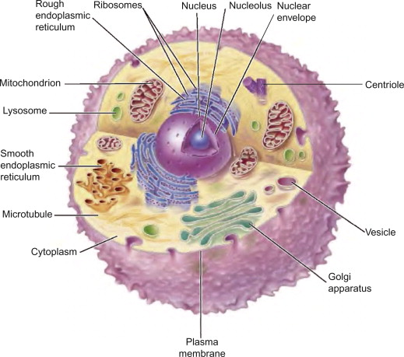
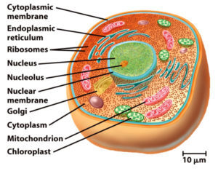

Slide 53
CONCLUSION:
In conclusion, the cell is the fundamental unit of life, serving as the building block of all living organisms. Whether prokaryotic or eukaryotic, each cell performs essential life functions through its various organelles, which work in harmony to maintain homeostasis, metabolism, growth, and reproduction. The intricate structure and diverse functions of the cell highlight its complexity and adaptability, showcasing its role as the smallest yet most crucial unit of biological organization. Understanding cells and their components forms the foundation of biology, providing insight into the processes that sustain life across all organisms.

Slide 54
THANK YOU!!

