Slide 1
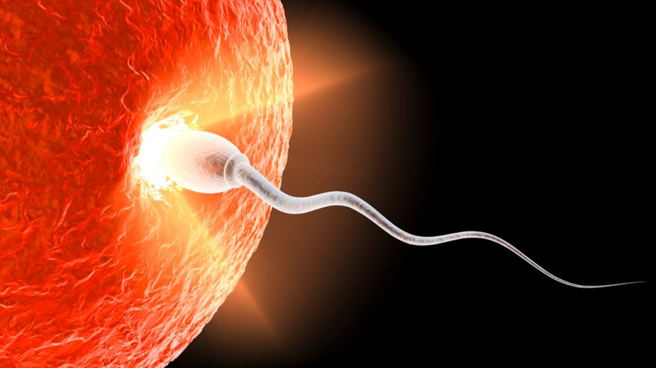
Human reproduction

Slide 2
What is Reproduction?
It is an biological process in which an organism give rise to young ones (offspring) similar to itself.
It is an cycle of birth, growth and death.
It enables the continuity of the species generation to generation.
In human, sexual reproduction take place.
Sexual Reproduction – When two parents participate in the reproductive process and also involves the fusion of gametes.
EVENTS IN HUMAN REPRODUCTION –
Gametogenesis
Fertilization (Zygote)
Cleavage
Morula Formation (Embryo)
Blastula Formation
Implantation
Gastrula Formation
Distribution and Differentiation (Foetus)
Gestation Period
Parturition

Slide 3
MALE REPRODUCTIVE SYSTEM –
Male reproductive system is located in the pelvis region.
It includes a pair of testes with accessory ducts, glands and external genetalia.
Testes are situated outside the abdominal cavity within the pouch called scrotum. The scrotum helps in maintaining the low temperature of the testes (2-2.5 degree C lower than the normal temperature of internal body) necessary for spermatogenesis.
In adult, each testes is oval in shape, with a length of about 4 -5 cm, and width of about 2 -3 cm.
Each testis has about 250 compartments called testicular lobules.
Each lobules contains 1-3 highly coiled seminiferous tubules in which sperms are produced.
Each seminiferous tubules is lined by two types of cells – the germ cells (spermatogonia) an sartoli cells.
The germ cells undergoes meiotic divisions to lead sperm formation and sartoli cells provide nutrition to the germ cells.
The region outside the seminiferous tubules called interstitial spaces, contain small vessels called leydig or interstitial cells, they synthesise and secrete terticular hormones called androgens.

Slide 4
The male accessory ducts include rete testis, vasa efferentia, epididymus and vas deferens.
The seminiferous tubules of the testis open into the vasa efferentia through rete testis. The vasa efferetia leaves the testis and open into epididymus.
This epididymus leads to vas deferens that ascends over urinary bladder, it receives a duct from seminal vesicle and opens into urethra as ejaculatory duct.
These ducts store and transport the sperms from the testis to outside the urethra and extends to through the penis.
Penis is the male external genetalia. The enlarged end of penis is called the glans penis is covered by a loose fold of skin called foreskin.
The male accessory glands includes paired seminal vesicle, a prostate and paired bulbourethral glands.

Slide 5
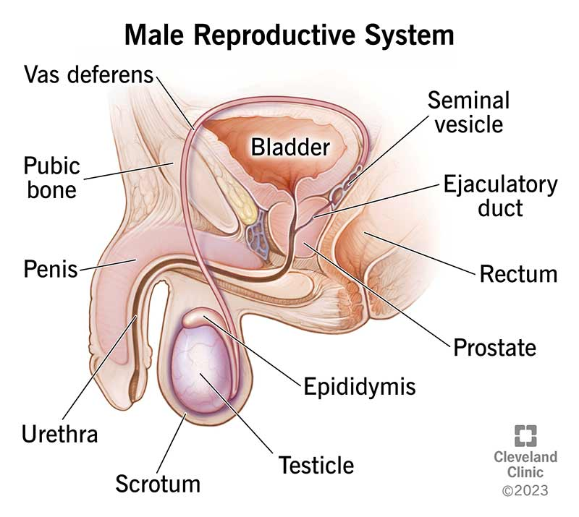

Slide 6
FEMALE REPRODUCTIVE SYSTEM –
The female reproductive system is consist of a pair of ovaries alongwith pair of oviducts, uterus, cervix, vagina and external genitalia located in pelvic region.
These parts involve with mammary glands structurally and functionally support the processes of ovulation, fertilization, pregnancy, birth and child care.
Ovaries are primary organs that prodice the female gamete (ovum) and several hormones.
They are located on each side of lower abdomen.
Each ovary is about 2-4 cm in length.
It is covered by a thin epithelium which encloses the ovarian stroma. The stroma is divided into two zones – a peripheral cortex and an inner medulla.
The oviducts (fallopian tube), uterus and vagina constitute the female accessory ducts.
Each fallopian tube is about 10-12cm long and extends towards uterus.
The part closer to the ovary is the funnel shaped infundibulum. The edges of infundibulum posses finger like projections called fimbrae, which help in collection of the ovum after ovulation.
The infundibulum leads to a wider part of oviduct called ampulla. The last part of oviduct called isthmus has a narrow lumen and it joins the uterus.

Slide 7
Utrus is also called womb. The uterus opens into vagina through a narrow cervix.
The cavity of cervix is called cervical canal which alongwith vagina forms birth canal.
The wall of uterus is made up of three layers –
external thin membrane – Perimetrium
middle thick layer of smooth muscle – Myometrium (strong contraction during delivery.
inner glandular layer – Endometrium (cyclic changes during menstrual cycle)
A functional mammary gland is characteristic of female mammals.
The mammary glands are paired structure that contain glandular tissues and variable amount of fat.
They contain 15-20 mammary lobes containing clusters of cells called alveoli. The cells of alveoli secretes milk, which is stored in the cavity of alveoli.
Alveoli opens into mammary tubules which joins to form mammary duct.
Several mammary ducts join to form mammary ampulla which is connected to lactiferous duct through which milk is sucked out.

Slide 8
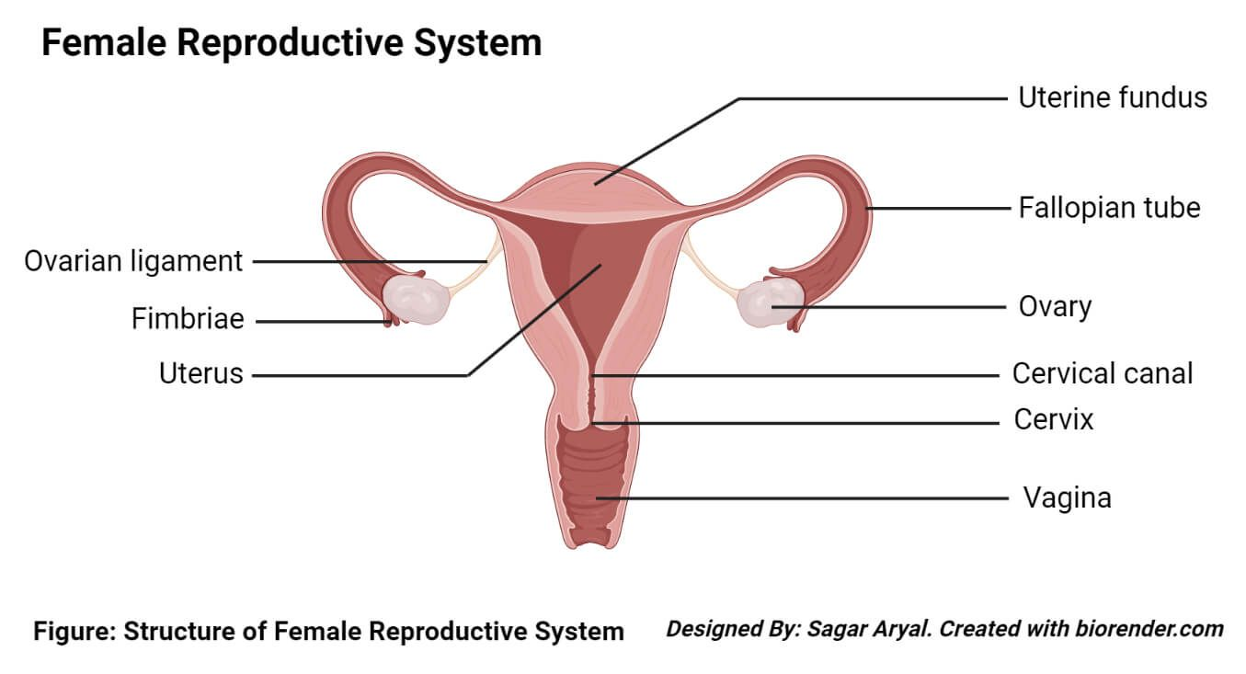

Slide 9
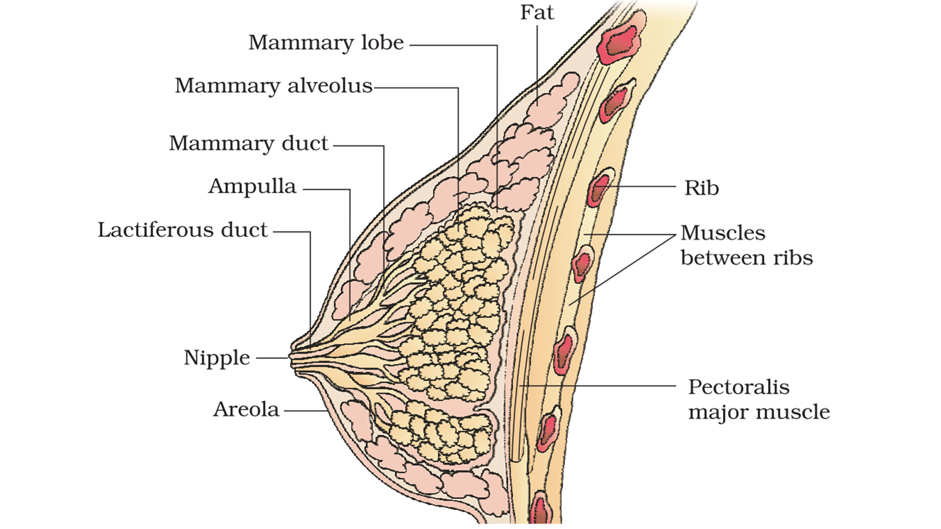

Slide 10
GAMETOGENESIS –
Gametogenesis is the process of formation of gametes i.e; sperms in males from testis and ovum in female from ovary.
It includes two types of formation –
Spermatogenesis
Oogenesis
Both processes contain three phases –
Proliferative phase/ Multiplication phase
Growth phase
Maturation phase

Slide 11
SPERMATOGENESIS -
The process of formation of spermatids is known as spermatogenesis.
It take place in testis of male.
It complete in two phases or process –
1. Spematogenesis
2. Spermiogenesis
(Proliferative phase) The spermatogonia (sing. Spermatogonium) S.M.C. present inside the walls of seminiferous tubules divides mitotically and increase in number.
Each spermatogonium are diploid in nature (46 chromosomes) .
(Growth phase) The S.M.C. are called primary spermatocytes (spermatocytogenesis)
(Maturation phase) This primary spermatocytes undergoes first meiotic division (reductional div.) and give rise to the formation of two equal daughter cells called as secondary spermatocytes which is haploid in nature.
The secondary spermatocytes undergoes second meiotic division and produce four equal haploid spermatids.
The spermatids are transformed into spermatozoa (sperm) by the process of spermiogenesis.
The head of sperm become embedded in sartoli cell and finally released from seminiferous tubules by the process of spermiation.

Slide 12
Action of Hormones during Spermatogenesis –
Spermatogenesis process starts at the age of puberty due to the increase in the secretion of GnRH
(Gonadotropin releasing hormones).
It acts at the anterior pituitary gland and stimulate two gonadotropin –
1. LH Hormone – Leuteinising Hormone act as leydig cells and stimulate secretion and
formation of androgens.
2. FSH Hormone – Follicle Stimulating Hormone acts as sartoli cells and stimulates the secretion
of sperm factors that will help in spermiogensesis.

Slide 13
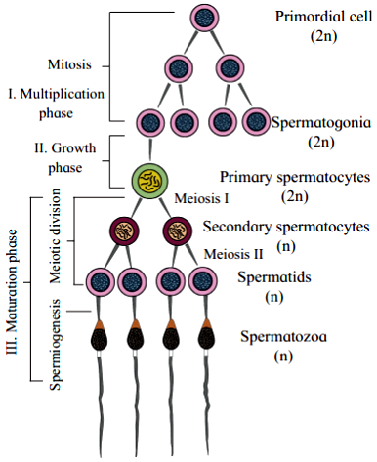

Slide 14
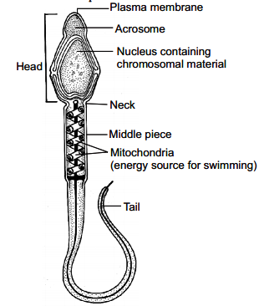
STRUCTURE OF SPERM –
It is microscopic structure composed of a head, neck, middle piece and a tail.
Whole body is covered with plasma membrane.
The head contain nucleus, protected by a cap like structure called acrosome.
The acrosome is filled with enzymes which helps sperm to fertilize the ovum.
The middle piece contain numerous mitochondria, which provide the energy for the movement of tail that provide motility.
The human male ejaculates about 200 to 300 million sperms during coitus.
Sperm released from seminiferous tubules are transported by the accessory ducts i.e; epididymus, vas deferens, seminal vesicle.

Slide 15
OOGENESIS –
The process of formation of ova/ovum/egg/ootid is known as oogenesis.
It take place in ovary of female.
It is not a continuous process, as number of ova in female is limited.
The ovary is composed of connective tissues called stroma, which is consist of outer cortex and inner medulla. Medulla region contains rounded bodies called ovaries or graffian follicles.
(Proliferative phase )The germ cells undergoes mitotic division and produce undifferentiated germ cells called oogonia or S.M.C.
After maturity the oogonia in follicles prepare to form ovum. Oogonia grows in size and called as primary oocyte.
An ovary alongwith follicle is known as ovarian follicle.
In growth phase of oocyte, the oocyte undergoes many structural changes.
In maturation phase, the primary oocyte undergoes first meiotic division or first maturation division/reductional division, and two unequal haploid daughter cells are formed.
One daughter cell is extremely large and the other one will be very small.
The large daughter cells is called as secondary oocyte and small daughter cell will be called as first polar body.
The daughter cells undergoes second meiotic div./second maturation div. and produce two unequal daughter cells.
The large cell is called as Ovum, and remaining three cells will be considered as second polar body.
By oogenesis, four haploid cells will produce out of which only one will able to diffrenetiate into ovum, remaining three are non-functional and dose not take participate in reproduction thus they will degenerate.

Slide 16
Arresting of Egg –
Oocyte paused at prophase I of meiosis I, and will continue at the time of puberty.
Oocyte again paused at metaphase I of meiosis II and continue at the time of fertilization.
An ovary alongwith follicle is known as ovarian follicle.
Primary oocyte – primary follicle
Secondary oocyte – secondary follicle
Tertiary follicle – mature or graffian follicle
The graffian follicle ruptures and release secondary oocyte from the ovary by the process of ovulation.
Corpus luteum.

Slide 17
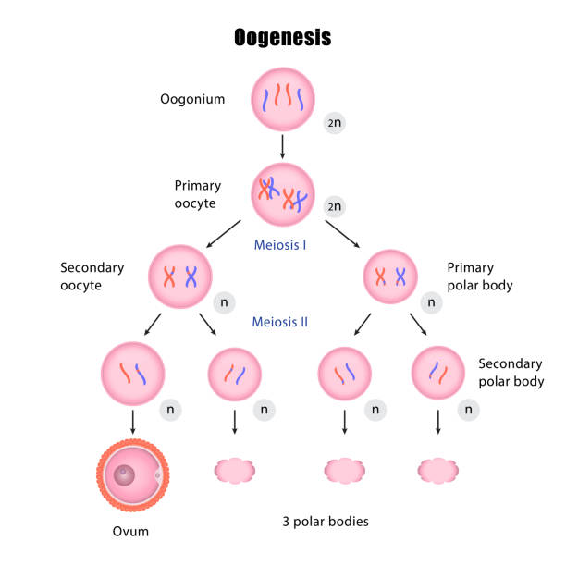

Slide 18
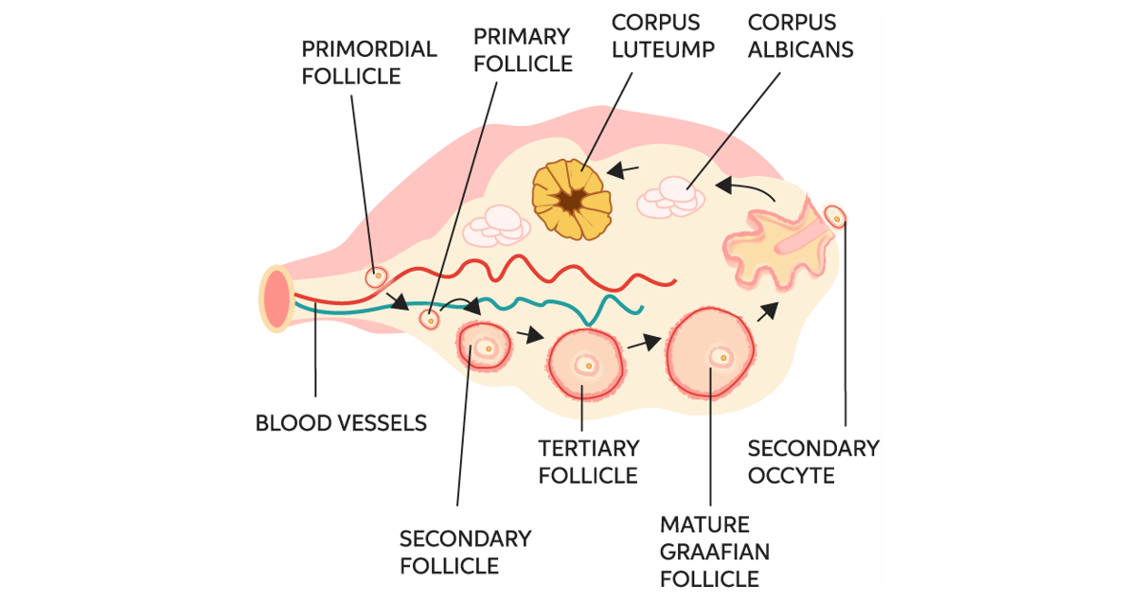

Slide 19
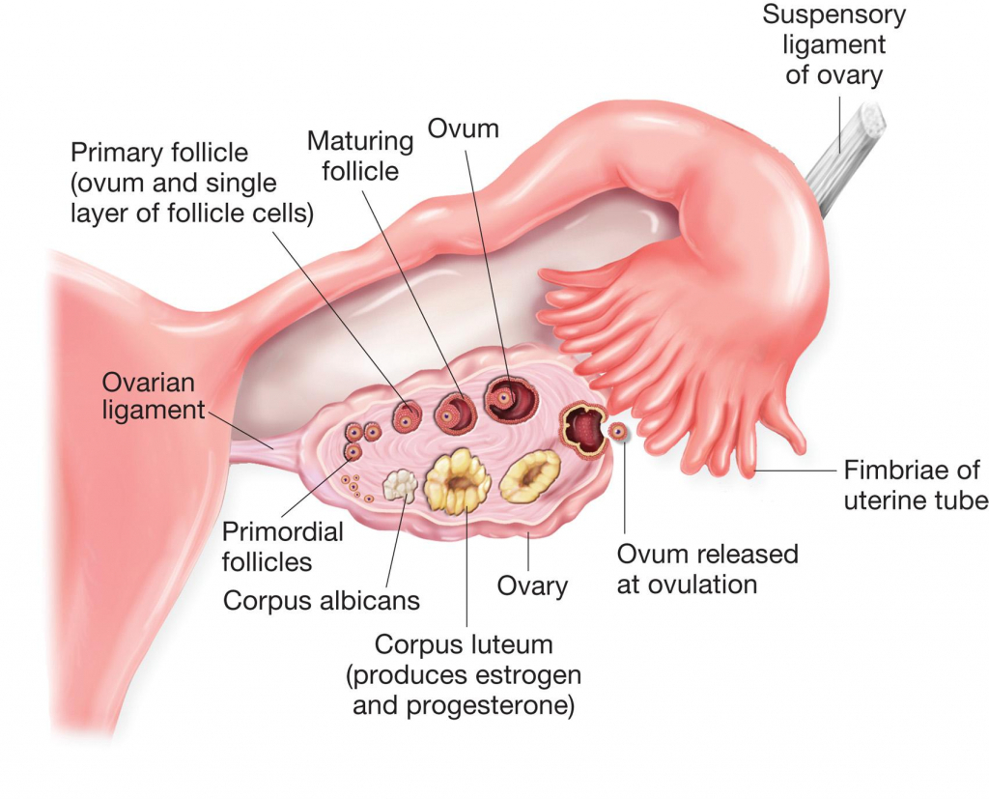

Slide 20
MENSTRUAL CYCLE –
The menstrual cycle is the monthly hormonal cycle a female's body goes through to prepare for pregnancy.
The first menstruation begins at puberty and is called menarche.
In human female, menstruation is repeated at an average interval of about 28/29 days and the cycle of event starting from one menstruation to next menstruation is called menstrual cycle.
One ovum is released during middle of the each menstrual cycle.
The cycle starts when menstrual flow occurs and it last for 3-5 days. The menstrual flow is result due to breakdown of endometrial lining of uterus and its blood vessels which forms the liquid that comes out through the vagina.
Menstruation will only occur if the released egg in not fertilized.
The menstrual phase is followed by the follicular phase. During this phase, the primary follicles in the ovary grow to become fully mature.
The LH and FSH increases during follicular phase. Both LH and FSH reach peak level in the middle of cycle (14th day).
Rapid secreation of LH leads to the rupturing of graffian follicle and release of ovum take place (ovulation).

Slide 21
The ovulation is followed by the luteal phase during which remaining part of graffian follicle transform as corpus luteum.
Corpus luteum secretes large amount of progesterone which is essential for maintenance of endometrium, because it is necessary for implantation of the fertilized egg.
During pregnancy, all events of the menstrual cycle is stop and there is no menstruation.
In human being, menstrual cycle cease around 50 years of age and is termed as menopause.
SO, menstrual cycle is the cycle between menarche to menopause.
Menstrual Phase – Bleeding
Follicular phase (Egg formation)
Rupturing of graffian follicle (ovulation)
Egg released – If Fertilized - it leads to pregnancy (Fertilization Phase) (about 14th day)
If not fertilized – removal of ovum
Luteal Phase -
Menstrual Phase – Bleeding (removal of unfertilized ovum)

Slide 22
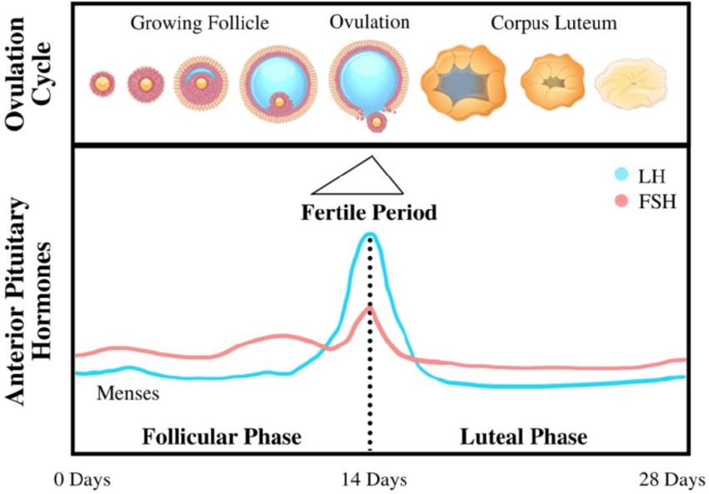

Slide 23
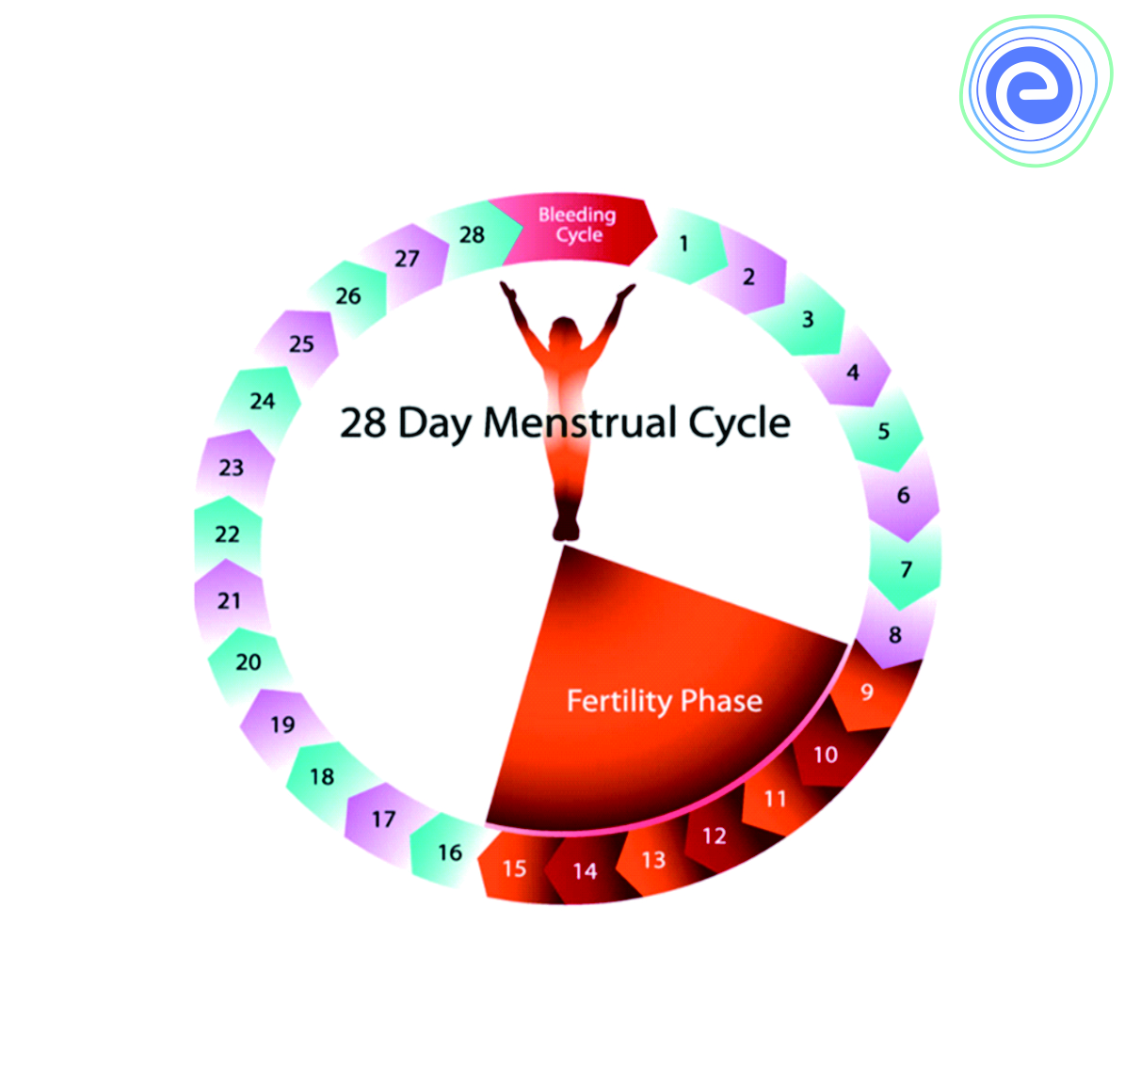

Slide 24
FERTLIZATION AND IMPLANTATION
The process of fusion of sperm and ova is called as fertilization.
During copulation semen is released by penis in vagina. The motile sperm travel, pass through cervix, enter in uterus and finally reach the ampullary region.
The ovum released by the ovary is also transported to the ampullary region.
The fertilization take place in ampullary region (fallopian tube).
Fertilization only take place when sperm and ovum transported to ampullar region.
During fertilization, a sperm come in contact with layer zona pellucida, and induces in membrane that blocks the entry of additional sperm.
Only one sperm can fertilize an ovum.
The acrosomal secretion helps sperm to penetrate the layers of ovum.
Soon sperm and ova fuses and together form a diploid zygote.
Male pronucleus and female pronucleus fuses.
The division starts as the zygote moves towards the isthumus called as the process of cleavage.
Zygote will develop from unicellular to multicellular by the process of cleavage and forms 2,4,8,16 daughter cells called as blastomeres.

Slide 25
The embryo with 8 to 16 cells/ blastomeres is called morula.
The morula continues to divide further and transformed into blastula.
The process of formation of blastula is known as blastulation.
The outer layer of blastula is known as blastoderm i.e outer layer trophoblast and inner layer cell mass.
The inner cavity or space of blastula is known as blastocoel.
The trophoblast gets attached to endometrium and inner cell mass will difffrentiated as embryo.
After attachement the uterine cells will divide and covers the blastula. As the result blastula will be embedded in the endometrium of uterus. This attachment is known as implantation which leads to pregnancy.

Slide 26
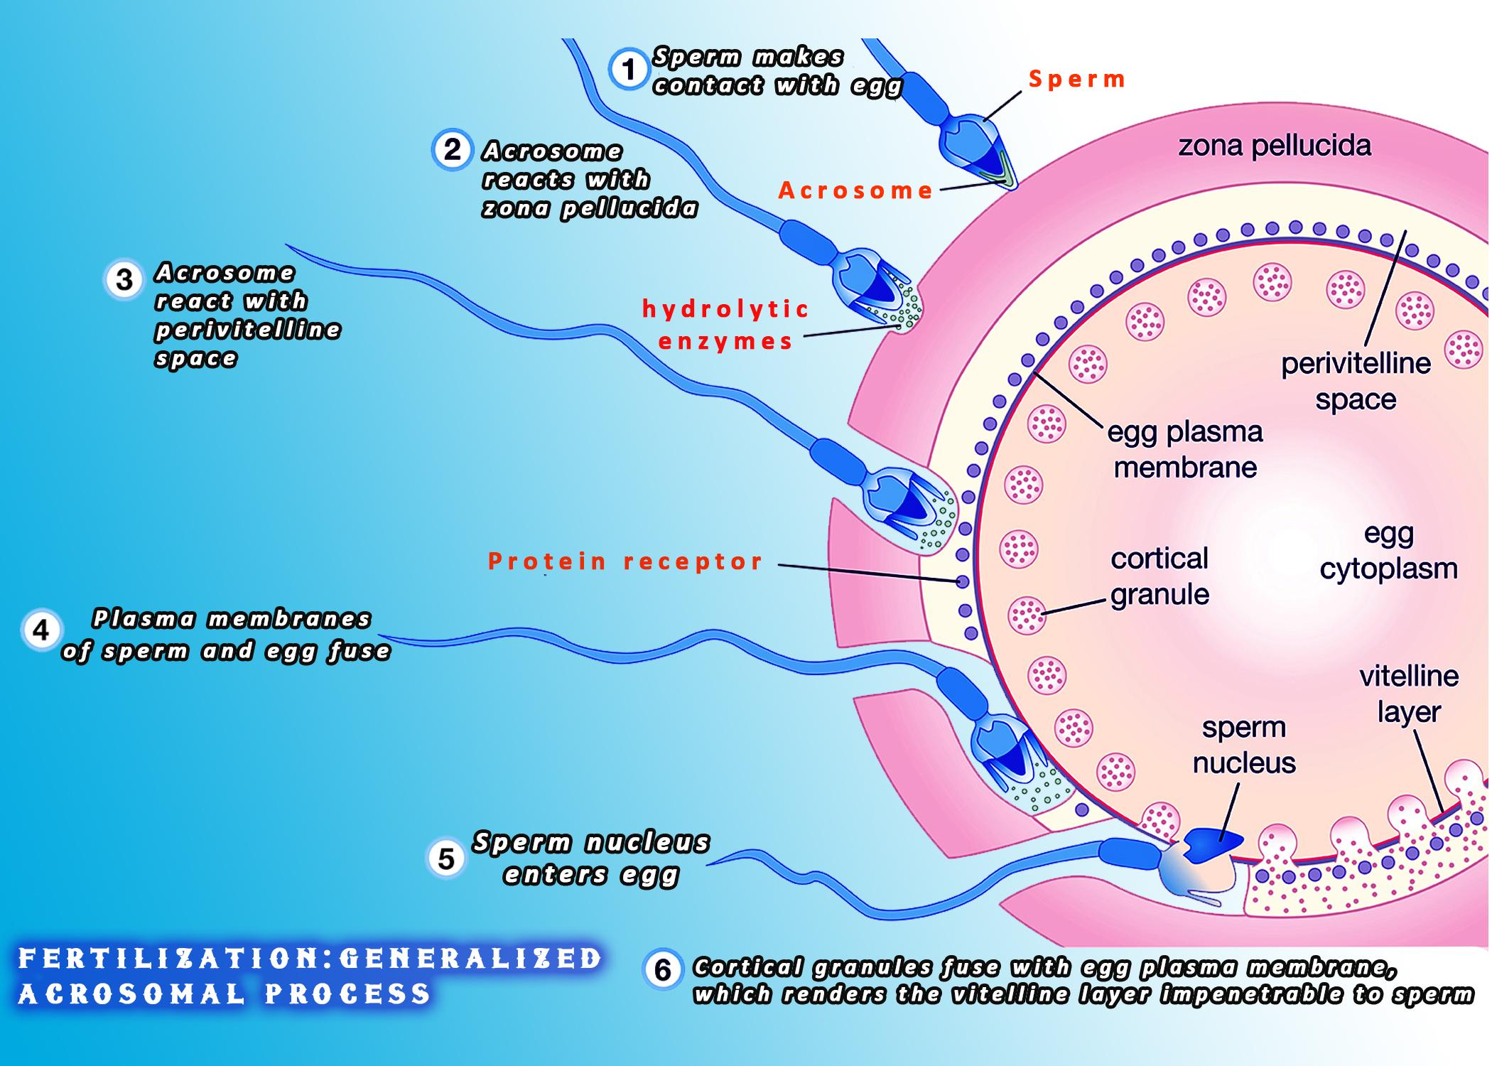

Slide 27
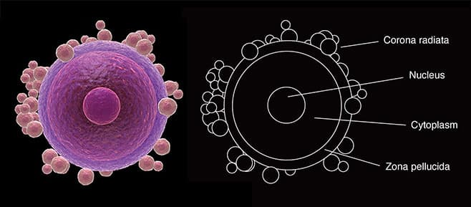

Slide 28
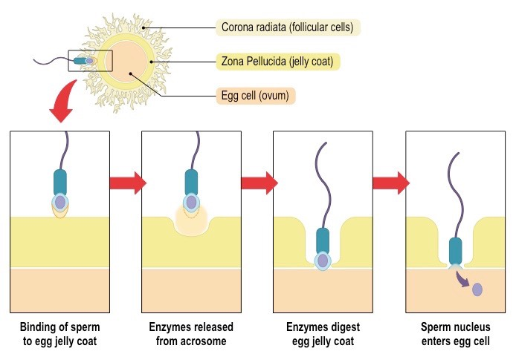

Slide 29
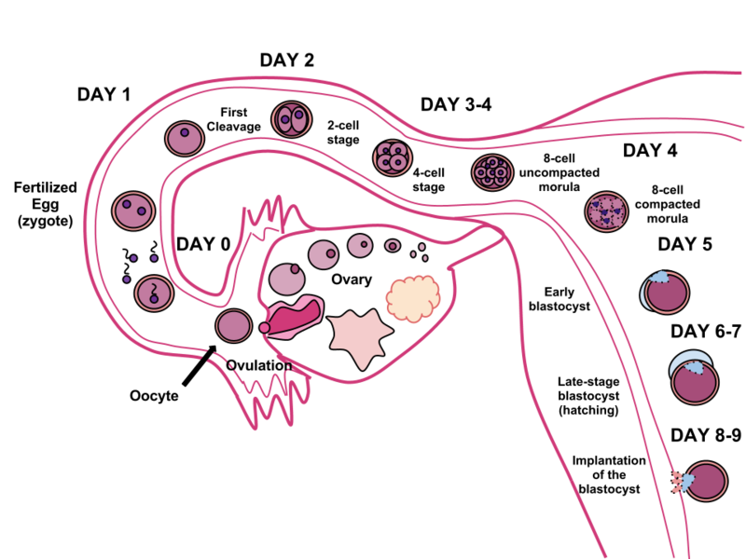

Slide 30
SEX DETERMINATION -
The chromosome pattern in human male is XY and human female is XX.
Therefore, in female gametes ovum, the sex chromosome will be X whereas in male gametes sperm the sex chromosome could be either X or Y, that means, 50% of sperms will carry the X chromosome, and 50% will carry the Y chromosomes.
After the fusion of male and female gametes the zygote will carry either XX or XY chromosomes depending on whether the sperm carry X chromosomes or Y chromosomes.
The zygote carrying XX chromosomes will be female baby and XY chromosomes will be male. That is scientifically, it is correct to say that the sex of the baby is determined by the father, not by the mother.

Slide 31
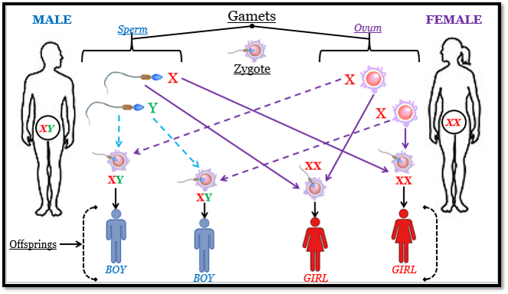

Slide 32
PREGNANCY AND EMBRYONIC DEVELOPMENT
After Implantation, finger like projection appears on the trophoblast called chrionic villi which surrounds by uterine tissue and maternal blood. Both are intedigitated with each other and jointly form structural and functional unit between embryo and maternal body called placenta.
The placenta facilitate the supply of oxygen and nutrients to the embryo and also remove CO2 and waste materials produce by the embryo.
The placenta is connected to the embryo through the umbilical cord.
It also produce several hormones like hCG (human chrionic gonadotropin, hPL (human placental lactogen, estrogens, progesterone etc.
In later phase it will also produce relaxin hormones.
During pregnancy the level of these hormones are maximum which is essential for supporting the fetal growth, metabolic changes in mother and maintenance of pregnancy.
After implantation, the embryo differentiated further and formation of three germ layers are take place. And this stage of development in known as gastrulation stage where the blastula is transformed into gastrula. (Ectoderm, Endoderm, Mesoderm)
The inner cell mass have specific cells called as stem cells which have capacity to give rise to all tissues and organs or complete organism.

Slide 33
Human pregnancy last for 9 months i.e;
Three trimesters –
First trimester – 1-3 month (12weeks)
Second trimester – 4-6 month (24weeks)
Third trimester – 7-9 month (36weeks)
After one month of pregnancy the embryo heart if formed. First sign of developing embryo.
By the end of second month, embryo develops its limbs and digits.
By the end of first trimester, major organs system are developed.
During 5th month, first movements and appearance of hairs on the head.
By the end of second trimester, the body is covered with fine hairs, eye lids separate, eyelashes are formed.
By the end of nine month, the foetus is fully developed and is ready to be delivery.

Slide 34
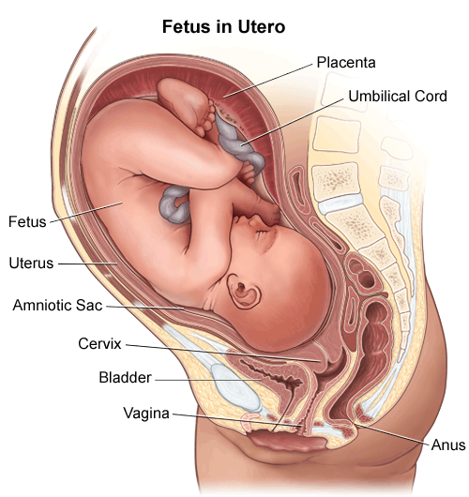

Slide 35
PARTURITION AND LACTATION
Period of 9 month of pregnancy is known as gestation period.
Vigorous contraction of uterus cause the delivery of foetus. This process of delivery of foetus is called parturition.
The signals for parturition originated from fully developed foetus and placenta which induces the uterine contraction called foetal ejection reflex.
This trigger release of oxytocin from maternal pituitary. Oxytocin acts on uterus muscle cause stronger uterine contraction which in turn stimulate secretion of oxytocin.
So uterine contraction and secretion of oxytocin results in stronger and stronger contraction.
This leads to the ejection of foetus through birth canal, and the placenta also expelled out of the uterus.
The mammary glands of female undergoes differentiation during pregnancy and starts producing milk by the process of lactation.
The milk produce during initial few days of lactation is called colostrum which contains several antibodies essential for new born babies.

Slide 36
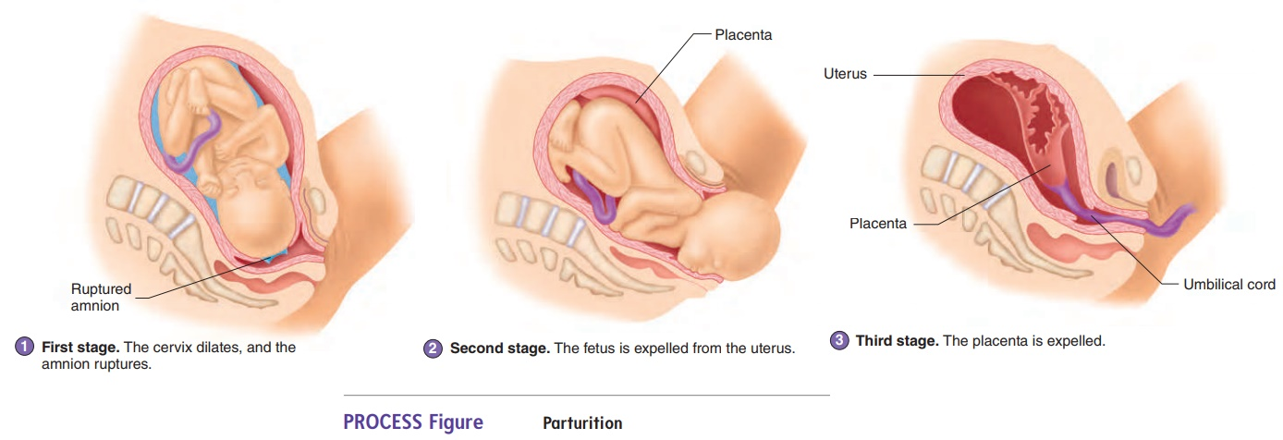

Slide 37
THANK YOU !!

